Slide 1
Case to support : school shelter construction in Yasnogorodka (Byshiv community, Kyiv region, Ukraine)
August 2023
Kyiv

Slide 2
Cover letter
Dear ladies and gentlemen!
The ongoing war in Ukraine continues to inflict immeasurable grief upon its people, causing damage to both human and animal alike. The devastating impact on infrastructure is a stark reminder of the turmoil that persists. In particular, the village of Yasnogorodka, a part of the Byshiv community in the Kyiv region, has endured the brunt of military operations since March 2022. The russian occupiers has left a trail of destruction, including severe damage to residential and social infrastructure. Regrettably, the school facility in the village has also been damaged.
In spite of the horrors of war, the children of Yasnogorodka yearn for a semblance of normalcy. They dream of attending school, acquiring knowledge, and nurturing their personal growth. However, the harsh reality is that traditional offline education in Ukrainian schools can only be made possible if adequate safety measures are in place to protect the children during missile attacks and drone strikes.
The shelter at the Yasnohorodka school falls short of meeting safety and hygiene standards, putting the children's lives at risk, it cannot be further exploited. Our goal is to rally our collective efforts with your invaluable support to construct new shelter, ensuring that the children have a safe haven to pursue their studies in the 2023/24 academic year.
Your participation in this noble endeavor would make an immeasurable difference in the lives of these young souls. By coming together, we can provide a glimmer of hope amidst the chaos and upheaval they face daily. Your involvement will not only rebuild a physical structure but also create an environment where children can flourish academically, emotionally, and socially.
We sincerely hope you will join us in this mission to transform the lives of these resilient children. Together, we can construct the shelter at Yasnohorodka school and gift the opportunity for pupils to learn, develop and live normal life.
Thank you for considering our plea. We eagerly look forward to your positive response and the positive impact we can achieve together.
Sincerely yours,
Antonina Vysota Julia Romanenko
CEO of U-RENEW foundation (Poland) CEO of URenew Public Organization (Ukraine)

Slide 3
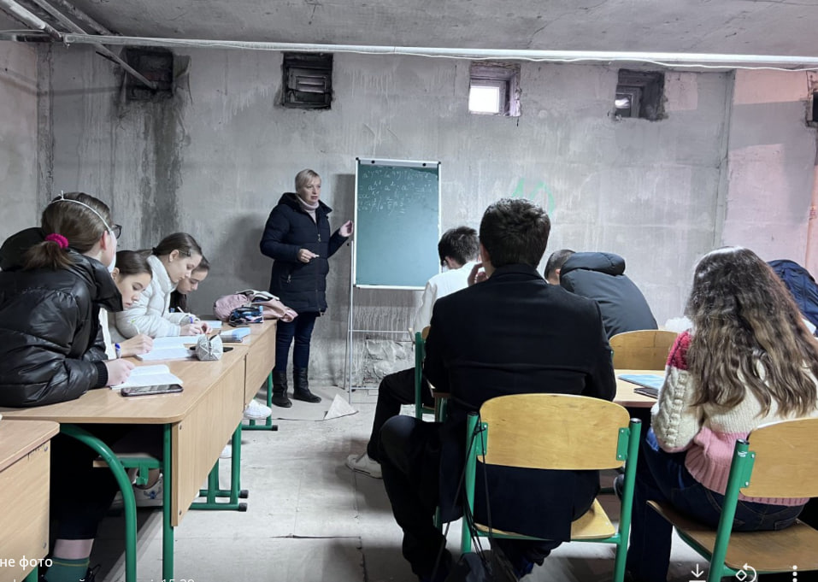
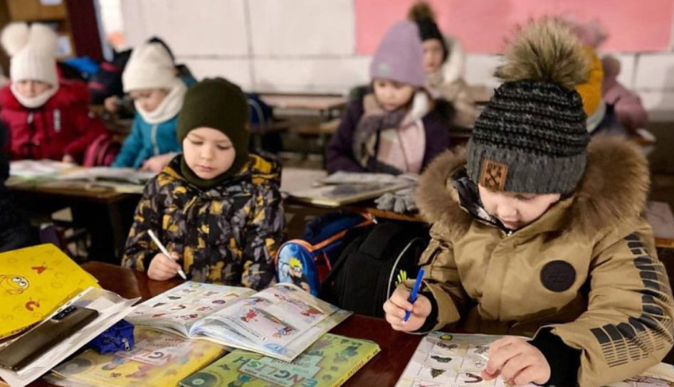
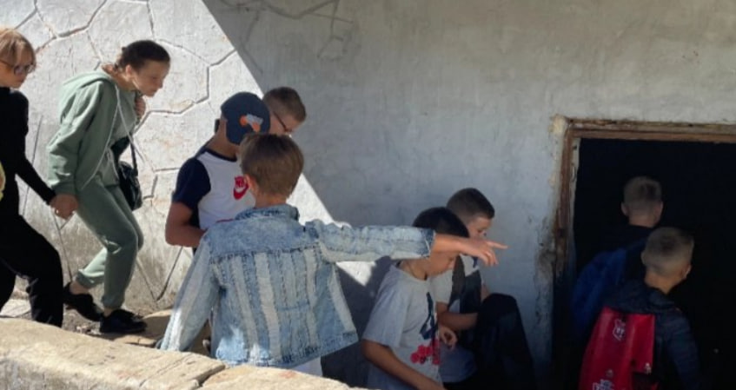
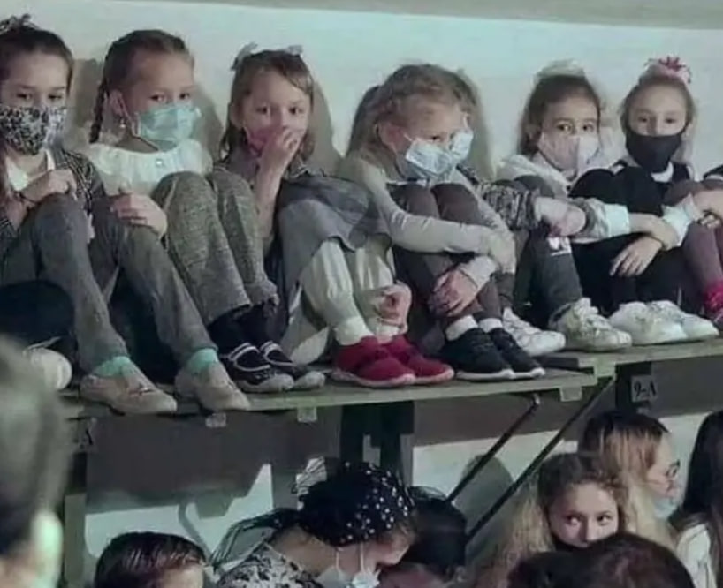
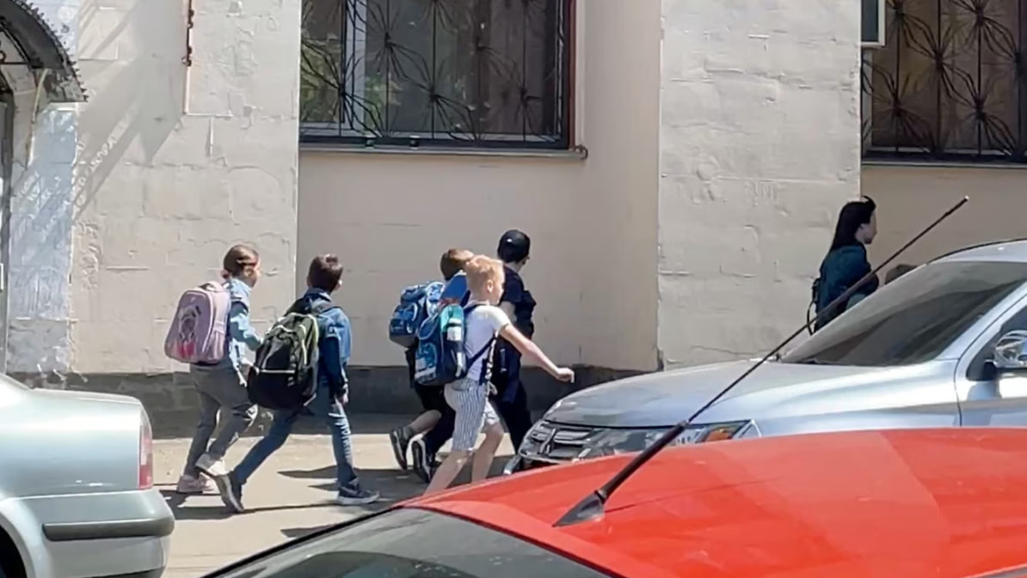
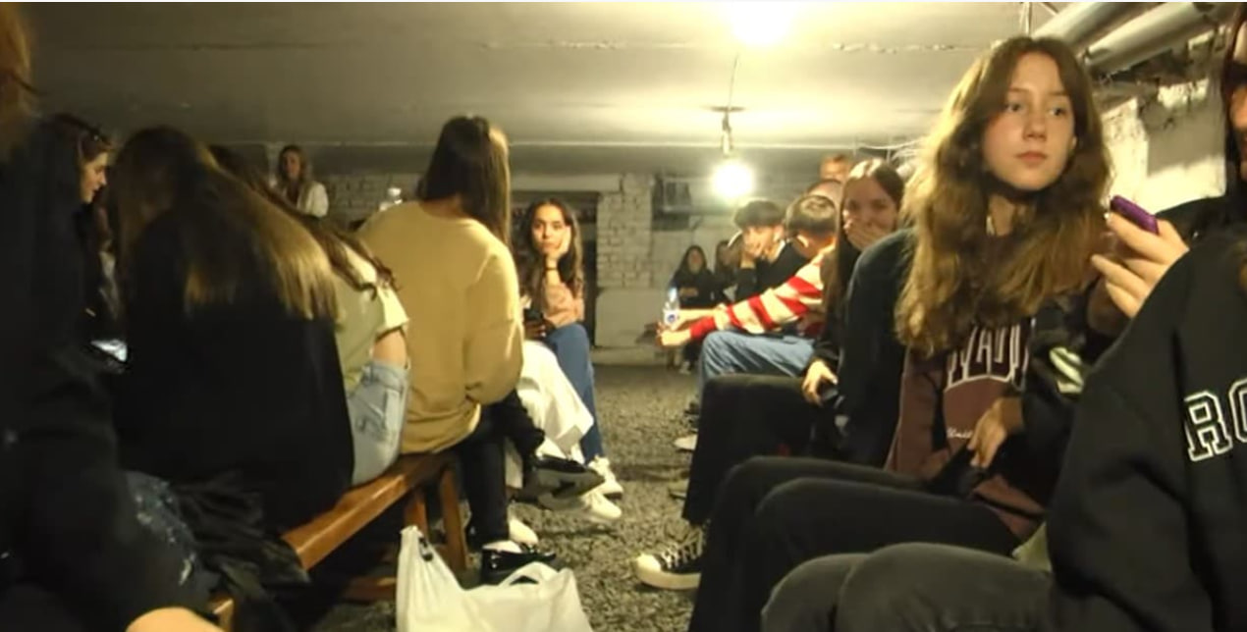
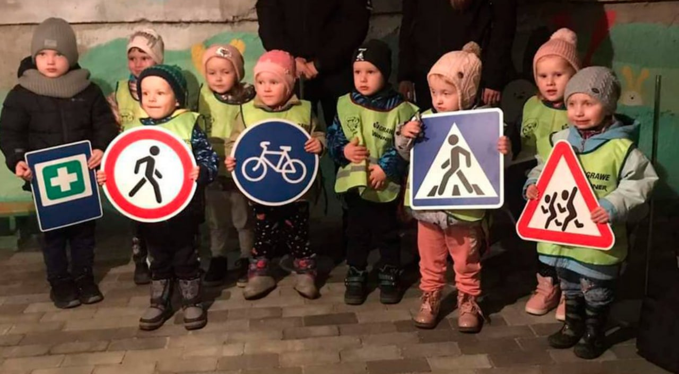
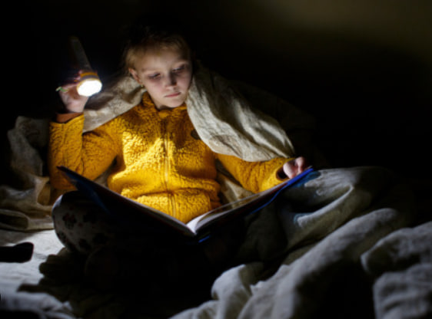
Childhood stolen by war
Imagine the life of an ordinary child
during a war…
From March 2022 - no studying and development; there is no opportunity to do sports, art; there is no possibility of normal interaction with peers.
From October 2022, when russian invaders began massively bombing the Kyiv region and launching drones - every child felt the horror of war – constant blackouts, cold, darkness, fear, rays of light in the intervals between rocket attacks.
But they are still children! They want to live even in conditions of war! They want to experience a normal life, to go to school, meet their friends, dream about the future, develop, achieve success and learn to experience failures, create, enjoy life.
For the children of Yasnohorodka village, this is currently impossible, because their school does not have a suitable shelter that could ensure their safety during russian attacks.
Our mission today is to help these children regain their childhood!
Let`s do this together!

Slide 4
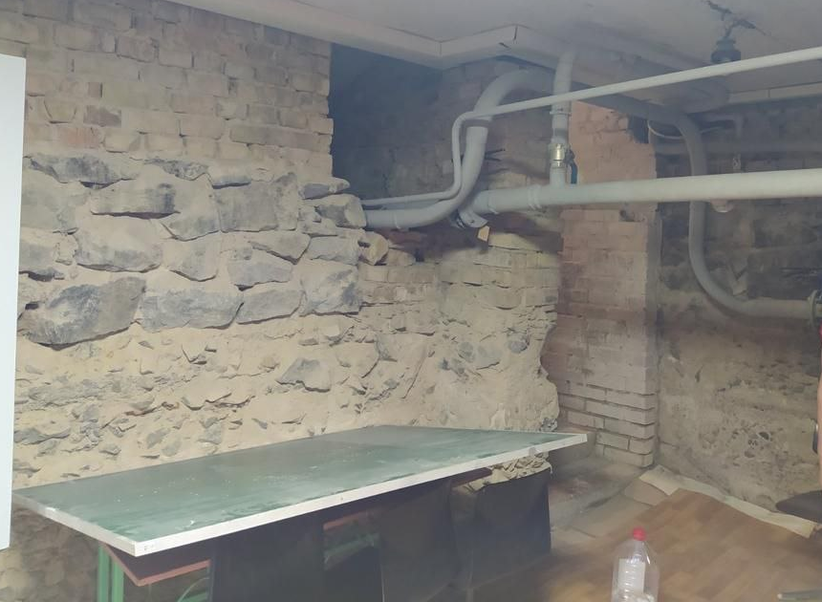
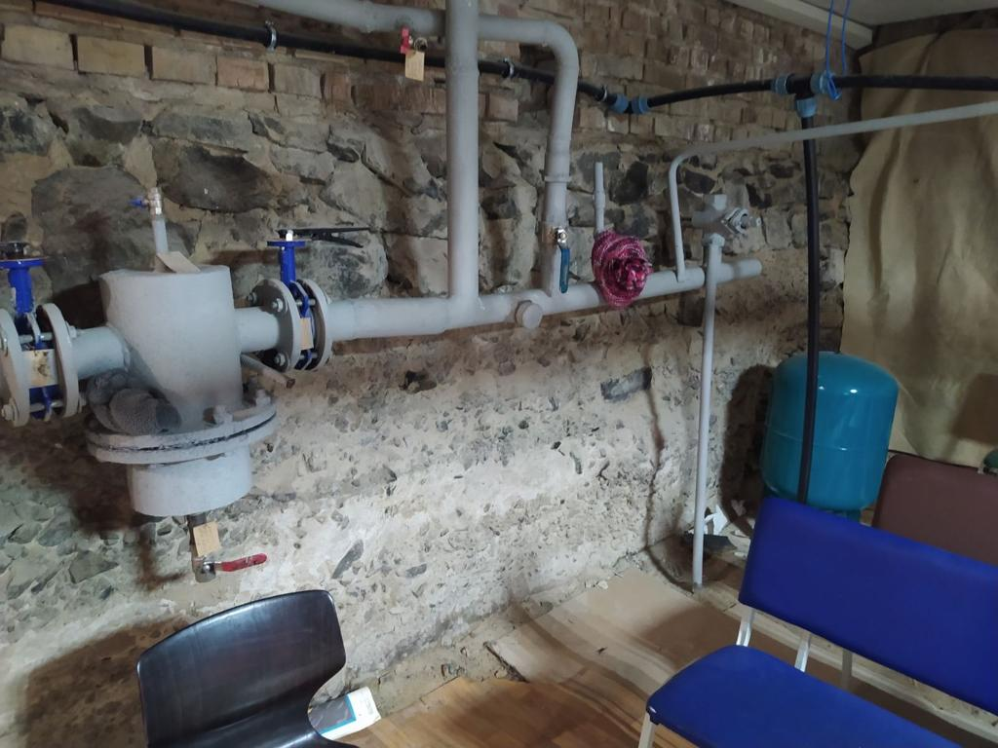
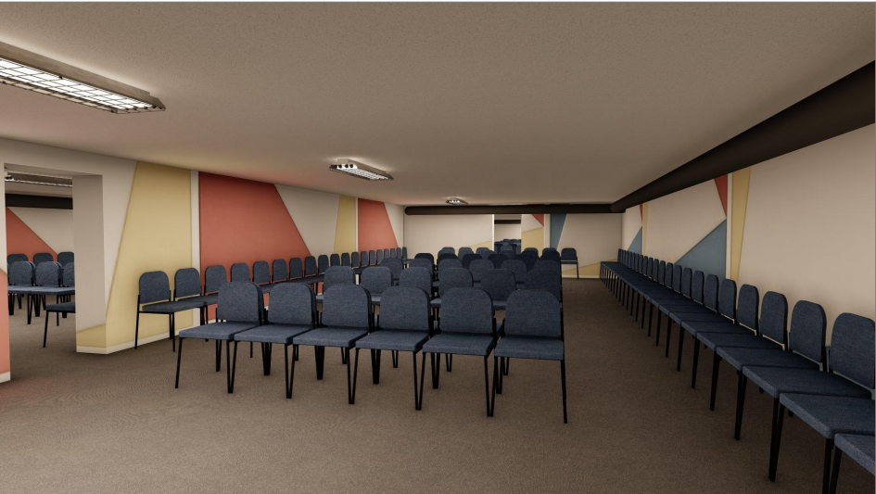
Case to support – school shelter construction in Yasnogorodka, Kyiv region
Needs description
Project objectives
To build up a shelter which allows:
get permission for off-line learning processes from November 2023
provide safety for pupils, personnel and continuity of the learning process during air alarm and missile attacks
Kyiv region is under constant rocket and drone attacks. Only in May 2023, 85 rockets and 169 drones were fired, 36 air alarms were announced in the Kyiv region, most of them accompanied by explosions.
Based on resolution of Ministry of Education an off-line education process in schools is permitted only if school has a shelter compliant with safety requirements.
Unfortunately, most of the schools in Kyiv region do not have appropriate shelters which comply with safety requirements, school in Yasnogorodka included.
Government aid comes with limited extent, thus Byshiv community looks for donors to finance school shelter in Yasnogorodka to secure offline education for 200 pupils and teaches
It’s extremely important to collect funds for shelter construction and complete all necessary work by November 2023, in order to provide the children with the opportunity to continue their offline learning process
Required financing
Based on project needs the total
budget is 150 000 $ where:
  110 000 $ – construction cost
  30 000 $ – communications
  10 000 $ - furniture and equipment
Fundraising deadline – September 30, 2023
Current state of school shelter
Target state
Square: 200 m2
Number of places: 200
Facilities: siting places, WC, mini-kitchen, playing space
Equipment: furniture, generator, TV

Slide 5
If you ready provide a gift…
… and your gift is less then 1 000 $
..and your gift is more then 1 000 $
Visit our website and donate through Donorbox:
https://www.urenew.org/
Choose the legal entity which is more suitable for your gift:
U-RENEW Foundation (Poland)
U Renew Public Organization (Ukraine)
1.
1.
Let us know if you want to publicly disclose your gift through our social media by contacting avysota@urenew.com.ua
2.
Contact Antonina Vysota for gift agreement signing
avysota@urenew.com.ua
2.
... and you are the USA resident
Please keep in mind that our project is fiscally sponsored of the Edward Charles Foundation (501(c)(3) non-profit organization)
3.
Sign gift agreement, provide a gift
1.
Follow-up the project status through our social media

Slide 6
URenew Mission and Values
URenew platform was launched by world fellowship to help Ukrainian communities with renewal after war destruction.
The aim of the project is to help communities to overcome current disaster bringing best world expertise and urban practice as well as attract funds for reconstruction and development
The pilot area – Byshiv community, Kyiv region, which was significantly damaged after russian occupation
Our Mission and Vision
Our Values
Here for the best future!
Comfortable and green environment
Renew community in accordance with best urban development practice and sustainability requirements
Place of choice for living
Ensure long-term community development through boosting high quality medical, education and cultural services, as well as inclusive environment
Wealthy and stable community
Create investment opportunities to attract business and generate new income streams for the community
World’s best practice to serve community needs. Most of the team members operate global with full awareness of the local context. It helps to combine community needs with world’s best practice.
Excellence and professionalism in project execution. URenew have gathered great team that is able to deliver full-cycle projects – from feasibility study and financing to go-live.
Integrity and transparency in everything we do. Our legal and operating model ensures full spend transparency - different legal entities and teams are responsible for fund raising and project execution. We assure effective internal controls at key project execution stages – sourcing and construction control

Slide 7
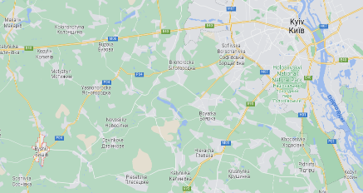
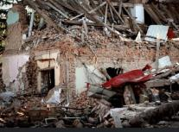
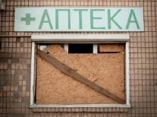
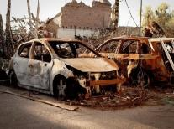
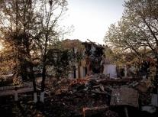
Byshiv community current state
Project prerequisites
Map and some info on Byshiv&Yasnogorodka
Byshiv community was in the war zone. The administrative center of the community, on March 3, 2022, was subjected to rocket fire (there were casualties), and on March 7, 2022, it was bombarded from the air.
The village of Yasnogorodka was under constant shelling during March 2022.
As a result, a total of 257 objects were damaged on the territory of settlements:
235 objects of the residential sector were destroyed or damaged, of which 37 buildings are to be dismantled, 32 buildings are to be overhauled, 166 buildings are to be repaired;
22 social and commercial objects were damaged or destroyed - 2 administrative facilities, 2 secondary schools, 2 kindergartens, 1 cultural center, 1 medical center
Currently more then 100 families with low abilities to rent housing are displaced and can not back to their homes
Renewal requires significant resources, and the Community understands that state aid will be limited and come with significant delays. Therefore, the Community decided to start rebuilding through the world fellowship involvement - humanitarian foundations, sponsors, investors, as well as concerned people from around the world
Byshiv community
Byshiv center village and 15 community villages with own infrastructure
+8000 residents
50 km from Kyiv
280 sq. km territory with a beautiful natural landscape
800 years of historical heritage since Kyiv Rus
10 km of the legendary Serpent`s Walls
1 famous ostrich farm

Slide 8
How URenew helps to renew community
Key challenges community meet during reconstruction
How URenew brings value
Lack on expertise at the community level on: project management mid- and high--scale housing development sustainable technologies |  | Our team has strong experience in implementing mid and large-scale development projects using most advanced sustainable technologies and project management approaches around the world – in Ukraine, CIS, EU, GCC areas
Lack of procurement best practice and expertise together with high corruption tolerance index (in whole country) |  | We pay special attentions to ensure full spend transparency and operations efficiency through: Involving best and world-recognized procurement experts in Ukraine to source our projects executing independent construction control auditing our activities by Big4 consulting team
Lack of expertise on fundraising and grant seeking |  | Our team has experience in fundraising using donorship inputs – we work with the biggest philanthropic organization around the world
No proper infrastructure in place – IT, tools, governance |  | URenew brings world’s best practice on: process tracking using ERP-system project management tools experienced experts on process automation
Lack of any HR resources - due to displacement and budget deficit community faced lack of qualified resources to execute even routine job |  | Except bringing our own expertise we put a lot of efforts to involve community and upskill its members through training session and special camping on strengthening community power
1.
2.
3.
4.
5.

Slide 9

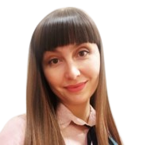
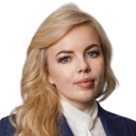
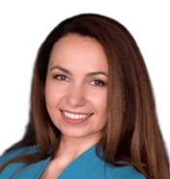


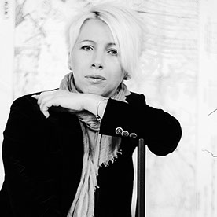
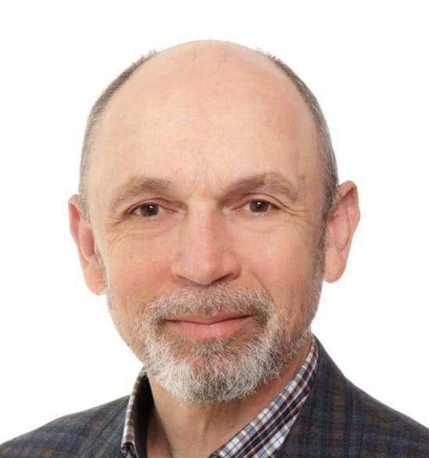
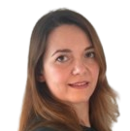


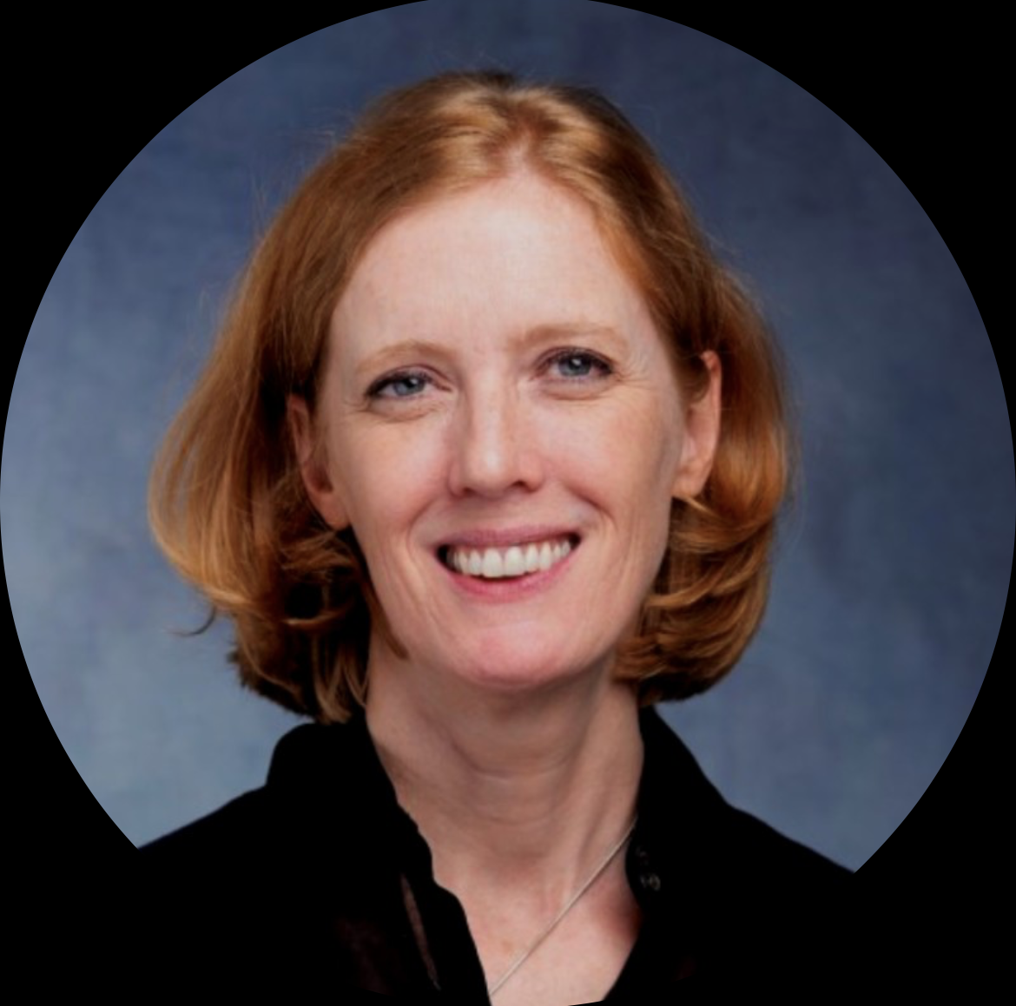
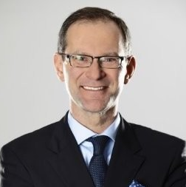


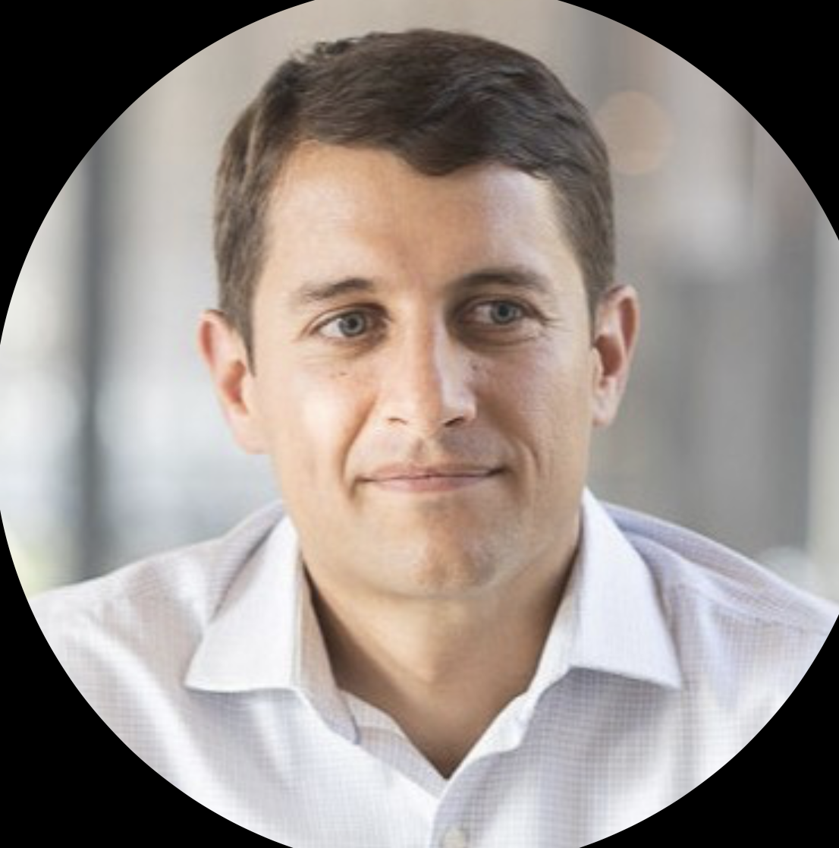
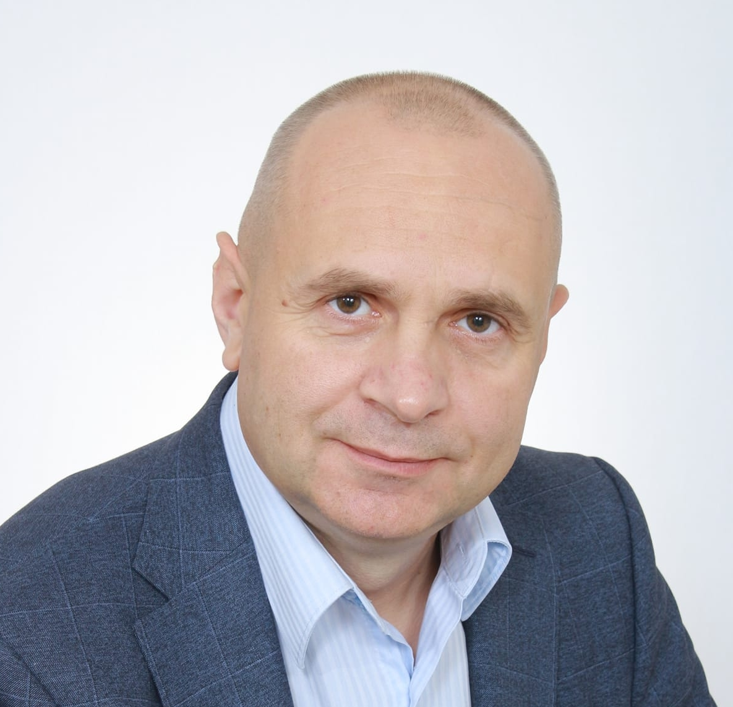
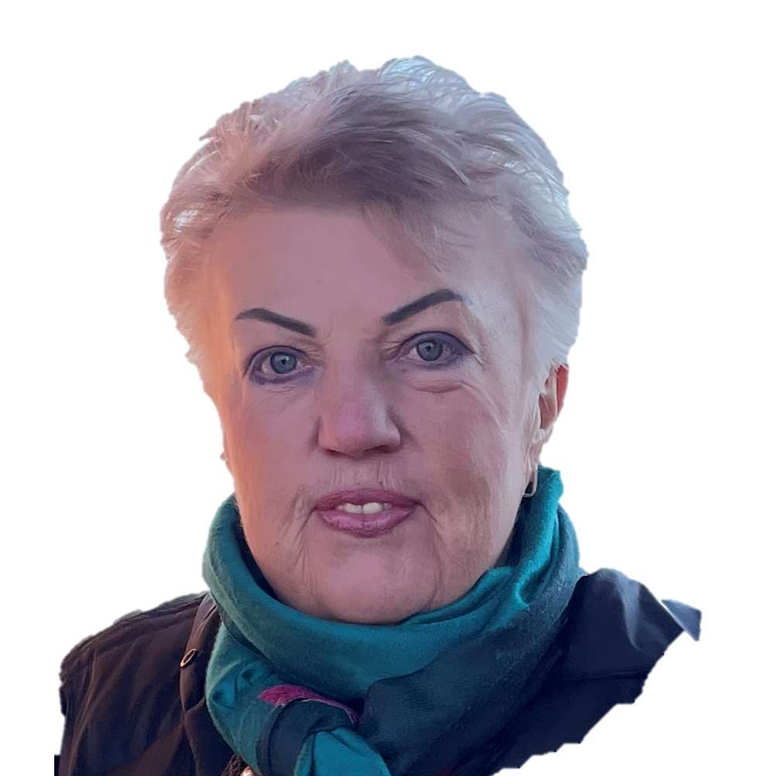


Our wizards for community renewal
URenew foundation
URenew project office
Supervisory Board
Victoria Zabayrachna
Maryna Koltsova
Iryna Povoroznyk
Julia Romanenko
Pavlo Podtopta
Oksana Shumelda
Member of the supervisory board, ACCA, Certified internal auditor
Chairman of the supervisory Board, MBA
Member of the supervisory board, MBA
Head of project office URenew/Financial controller
Owner of Denza Construction,
Project partner on project management and development
Project partner on urban conceptual design
Management team
Stanislav
Melnyk
Antonina Vysota
Maryna Ryzhkova
Lina Zhiginas
Joanne
Dixon
Robert Grygiel
Accounting and reporting
CEO of URenew foundation
Grant management
CEO of KMDШ, MBA Project partner on Education
Managing director
Energy Markets Group, MBA
Project partner on green power
President of Wapeco, MBA
Project partner on Sustainable technologies
Byshiv community representatives
Back-office support
Legal support
Halyna
Nazarenko
Maryna Trepova
Viktor Ghereg
Sergii Ostapchuk
Ivan
Roznai
Head of Byshiv Community
Former head of Byshiv satellite community (Yasnogorodka)
Founder of IPSM, MBA
Project partner on Sourcing
Founder of Medical Foundation of Moldova, MBA
Project partner on Medicine
Partner on compliance and digital processes
Marketing team

Slide 10
Why URenew
1.
URenew have gathered great team that is able to deliver full-cycle projects – from feasibility study and financing to go-live
URenew supports local tangible projects with high-scalability
Most of the team members operate global with full awareness of the local context. It helps to combine community needs with world’s best practice
Our legal and operating model ensures full spend transparency - different legal entities and teams are responsible for fund raising and project execution
We assure effective internal controls at key project execution stages – sourcing and construction control
URenew provides high fund security and fiscal benefits to donors since the foundation is tax resident of EU (Poland)
2.
3.
4.
5.
6.

Slide 11
URenew operating model
Fundraising
Execution
Import contracts (cost of materials & equipment supply)
Project office operations
Funds to finance reconstruction (~85% of donations)
Donors
Platforms
URenew foundation
Byshiv community
URenew project office
Government agencies
Donorbox
Corporate donors
Supervisory Board
Scope responsibility matrix for each project
Defining financial plan
International organizations
Crowdfunding
Private foundations
1
2
3
Management
Financing volume defining, %
Subcontractors Qualification and Tendering for volume under financing
Contracts with suppliers and subcontractors
Financial institutions
Subcontractors:
Marketing: State Group LLC
Accounting and Legal:
E-REPORT, EUCON
PR & GR team
Endowment funds
Capital campaigns
URenew Steering Committee
Philanthropists
Construction is in financing scope->
Construction control
Individuals
Project prioritization
If all project is in financing scope ->
Project management
Ecosystem
Joint promotion
Agents
Execution control
Local contacts
Associations
Partners
Partners
Consult
Execute activities

Slide 12

Legal status
Legal status of URenew in EU
Legal status of URenew in Ukraine
Legal status of URenew in USA
NGO, number of identification NIP – 7011130968
Public organization, ID 45122005
Is a fiscally sponsored non-profit organization project of the Edward Charles Foundation which is a 501(c)(3) non-profit organization (Tax ID# 26-4245043).
Address
Address
Address
Jana Dantyszka street, 18, Warsaw, 02-054, Poland
Yasnogorodka, Kyivska street, 47, Fastiv district, Kyiv region, Ukraine
Mailing Address: U-RENEW Foundation
269 S Beverly Drive, #338
Beverly Hills, CA 90212
Attention: Kent Seton
Registration date
Registration date
Registration date
23-02-2023
18-04-2023
August 2023
Supervisory board
Founder
Founder
Maryna Koltsova - Chairman of the Board
Iryna Povoroznyk – Member of the Board
Viktoriya Zabayrachna – Member of the Board
Julia Romanenko
Halyna Koltsova
Maryna Koltsova
Serhii Ostapchuk
Iryna Povoroznyk
CEO of the foundation
CEO of URenew Project office
CEO of URenew fiscal sponsored project
Antonina Vysota
Julia Romanenko
Antonina Vysota
Payment details
Payment details
Payment details
Bank: POLSKA KASA OPIEKI SA - BANK PEKAO S.A.,
GRZYBOWSKA STREET, 53-57 , WARSAW, 00-844, Poland
EURO: PL60 1240 1040 1978 0011 2358 4570
USD: PL09 1240 1040 1787 0011 2358 4756
PLN: PL02 1240 1040 1111 0011 2358 4150
SWIFT: PKOPPLPW
Bank: FIRST UKRAINIAN INTERNATIONAL BANK
UAH: UA763348510000000026003200425
EUR: UA763348510000000026003200425
SWIFT: FUIBUA2X
Enterprise Bank & Trust
150 N Meramec Avenue
Clayton, MO 63105
U-RENEW Foundation
Account #: 2405124
Routing No: 081006162

