Slide 1
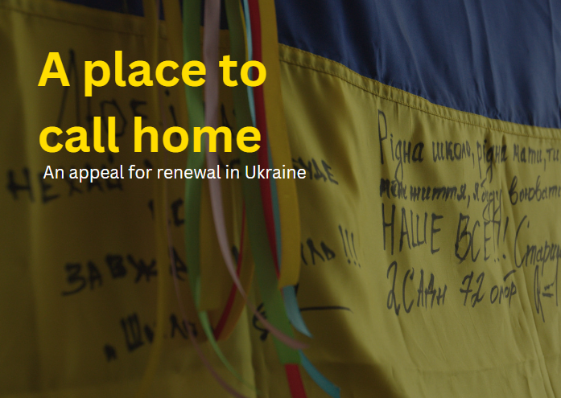

Slide 2

URenew is a foundation launched by a global fellowship of professionals working across design and urban practice. We all have roots in Ukraine and care passionately about rebuilding a stronger, united and prosperous country following the devastation of Russian occupation.
Starting with Byshiv.

Slide 3
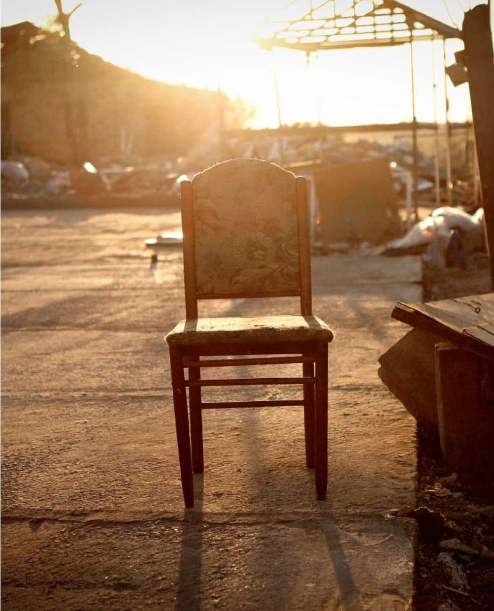
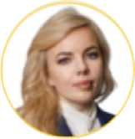
My home is Byshiv, Ukraine. 50.2646° N, 29.8836° E
It’s also home for over 8,000 Ukrainian people. The Byshiv community encompasses 15 villages nestled in stunning natural scenery, cross-cut by the ancient Serpent’s Wall system of defensive earthworks. For a millennium, people have called Byshiv home, prospering from its fertile farmland.
On 3 March 2022, Russian forces launched a missile strike on Byshiv followed by fierce fighting in surrounding villages.
What remains now is barely inhabitable. Our homes have been destroyed, our schools burnt-out, and our families torn apart. Images of Byshiv and the ‘Road of Death’ to neighboring Yasnogorodka quickly spread around the world.
To those who stayed behind to defend our community - some with their lives - we owe a lifelong debt of gratitude. Now, we must stand together to create a better and brighter future for Ukraine.
Maryna Koltsova
Chair of URenew Foundation

Slide 4
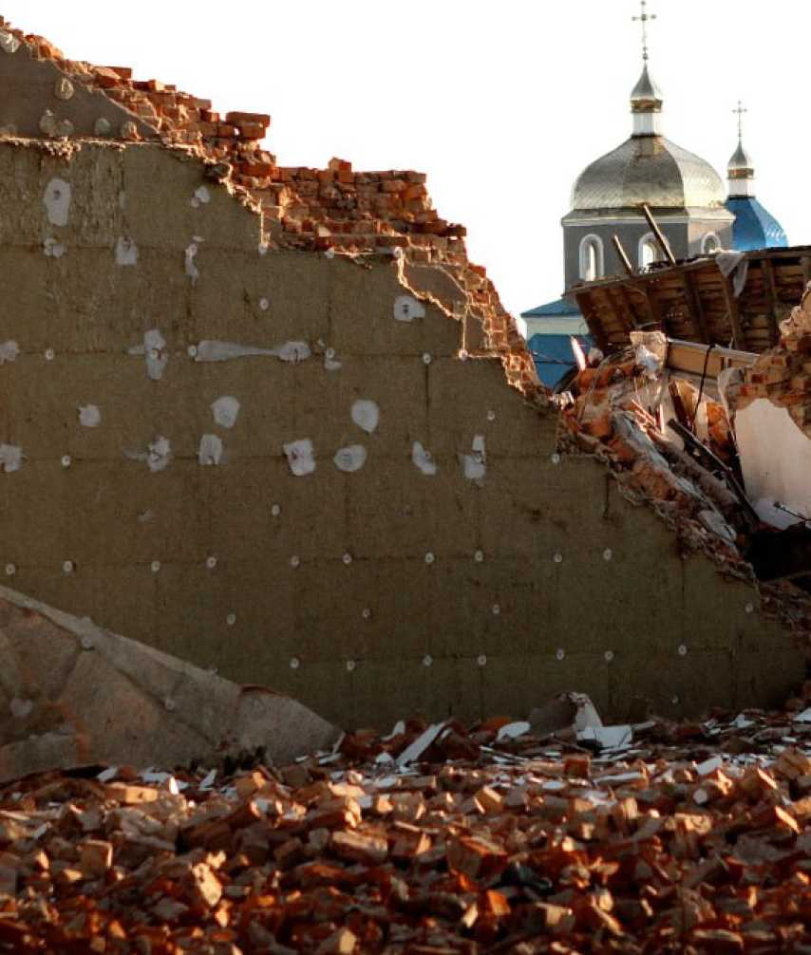
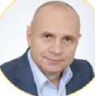
Tyт для кращого майбутнього
Here for the best future
«Hapaзі життя в Україні зупинилося. Нам терміново потрібно піднімати на ноги такі громади, як наша. Ремонт пошкоджених будинків, відбудова шкіл та садочків, захист культурної спадщини відновлять серце і душу місцевих громад. Якщо ми не діятимемо зараз, багато мешканців будуть змушені виїжджати з нажитих місць, а Україна втратить найдорожче, що має – людей. З допомогою URenew ми працюємо над тим, щоб побудувати краще майбутнє для Бишева, а також для України. Ми щиро вдячні за Вашу підтримку.»
Right now, life in Ukraine is on hold. We urgently need to get communities like mine back on their feet. Repairing homes, rebuilding schools and protecting our cultural heritage will restore the heart and soul of local communities. If we don’t act now, more residents will be forced to leave and Ukraine will lose its most precious possession - it’s people. Through URenew, we are working to build the best future for Byshiv and Ukraine. We are truly grateful for your support.
Ivan Roznai
Head of Byshiv Community

Slide 5
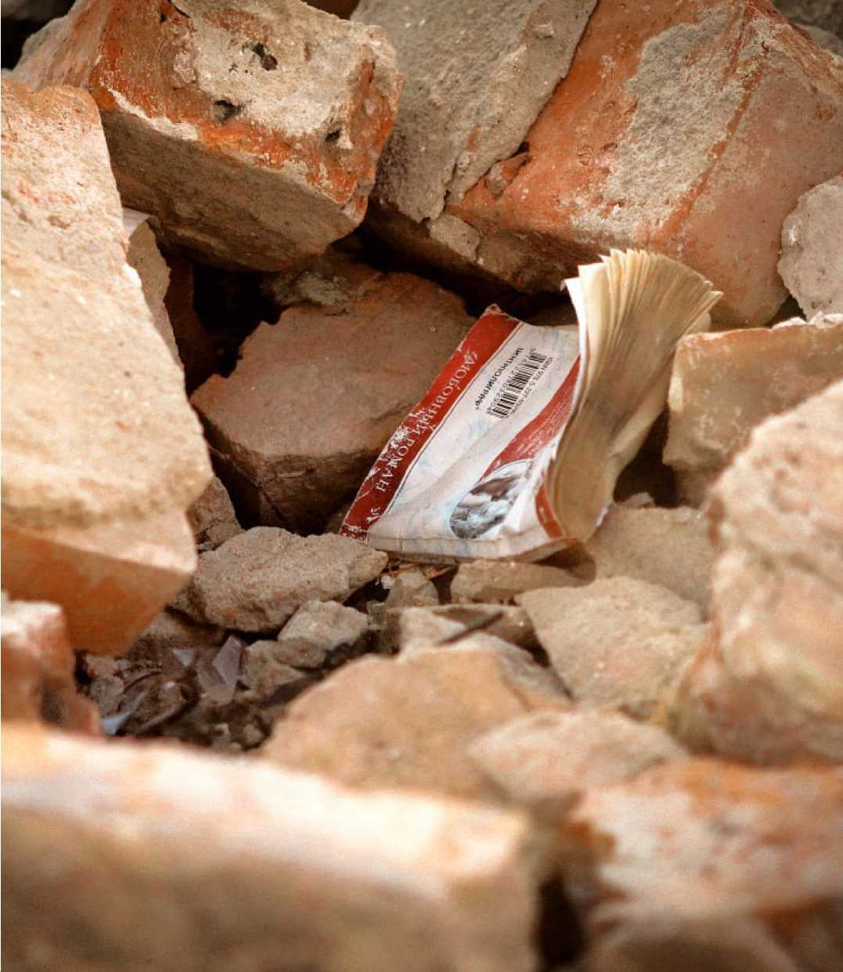
Byshiv as a blueprint for renewal
Just as Byshiv became a symbol of needless destruction around the world, it can become a beacon of hope for a better future for Ukraine.
Lack of expertise, capacity and language skills are hindering local communities like Byshiv from benefiting from international aid support and developing localised solutions that work for them.
Through a reconstruction programme that is community led and financed, we believe Byshiv can emerge from the devastation of war as a sustainable model for renewal across Ukraine.
We can bring world-leading expertise in urban practice and sustainability to work with residents to create a brighter and more resilient future.
Through partnership, business, philanthropic and investment opportunities, we’re creating a vision for Byshiv that can be replicated in home-towns across this incredible country.
Renewing Ukraine starts now. And it starts in Byshiv.
We are U Renew. Join us.

Slide 6
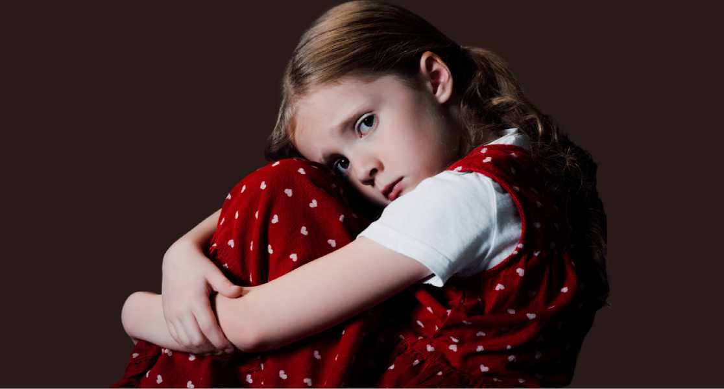
The gift of life returned
"When the school in Yasnogorodka was damaged, it was no longer safe for my children Makar and Katrusya to go to school. Since March, they've been studying either online, separated from their friends, or in school, risking their lives. During rocket or drone attacks, parents have to quickly bring their children home. I am a doctor, so my constant presence in the hospital is crucial for both me and my patients. We are watching a generation lose their childhoods to war and we live daily with the uncertainty of what might come next. We need to start living our lives again but to do that, we need as much help as possible. It not really about bricks and mortar, it’s about hope, belonging and community.”
Ulyana Duchenko
Family doctor in Byshiv community.
Counting the cost of war
Byshiv:
6 civilian lives lost
50 families displaced
256 buildings destroyed or damaged
2 cultural centres
2 schools
2 kindergartens
1 medical centre
1 castle
225 homes
Est. cost: $35 million
Ukraine:
9,511 civilian lives lost by Aug 2023
Over 8 million families displaced
Countless buildings destroyed or damaged
24,000km of roads and 346 bridges
715 hospitals
1,520 cultural and religious centres
274 UNESCO heritage sites
3,400 schools and educational institutions
167,200 homes
Est. cost: $150 billion

Slide 7
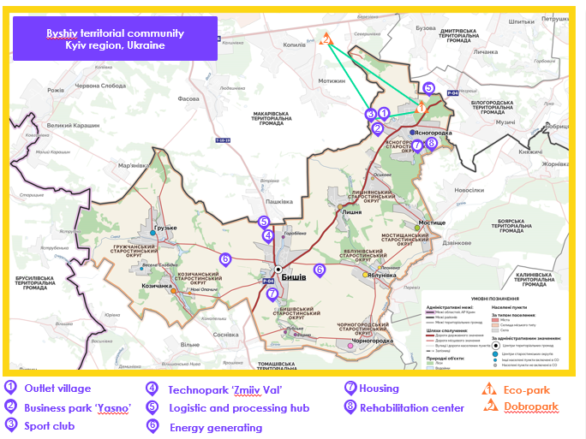
Why Byshiv?
Our vision for Byshiv is not just driven by the urgency of human need, but the strategic opportunity that it presents for wider Ukraine.
We believe the following factors make Byshiv a prime location to pilot an ambitious, sustainable model for regenerating the country from the devastation of war.
Prime location for business
Byshiv is 50km from the capital, Kyiv, and well connected by the Kyiv/Lviv highway and European road routes that span across Europe from as far as the port of Calais in France. With an affordable cost of living, Byshiv is an attractive area for relocation, expansion and further private investment.
A skilled workforce
Existing business and technology parks, as well as tourist centres, will attract a wide range of professional skills across engineering, IT, science, agriculture and hospitality.
Tourism opportunities
The largest Ostrich farm in Yasnogorodka (Eco-park) and the region’s spectacular flower park (Dobropark) and outlet village will create a thriving weekend getaway, providing positive family opportunities in the wake of the devastation of war.
* All projects are subject to conceptual design phase and community approval process

Slide 8
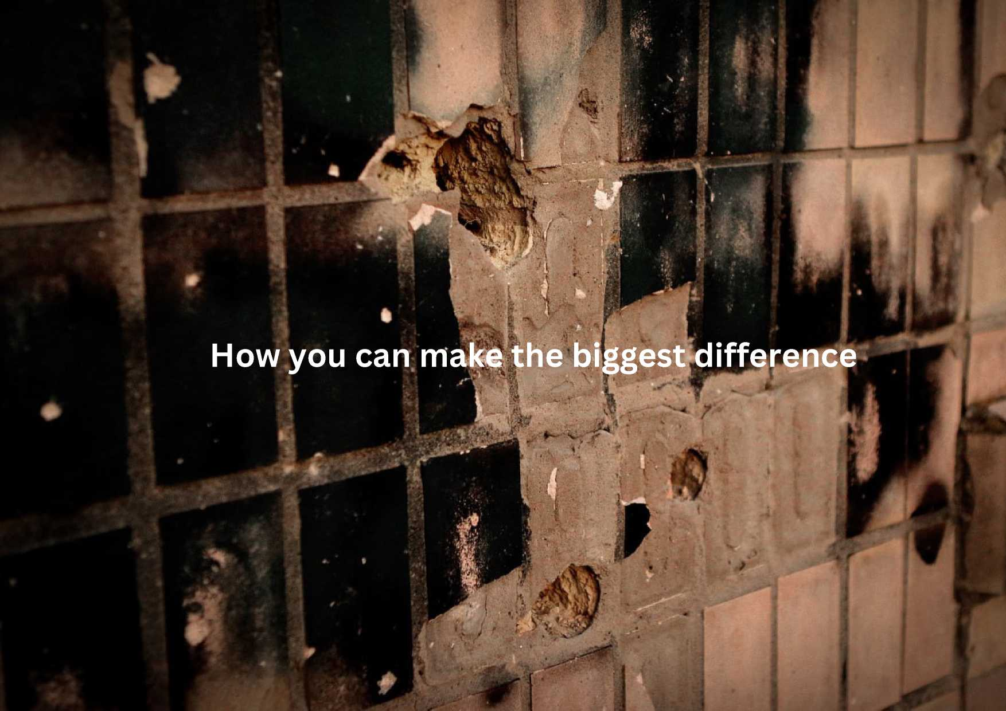

Slide 9
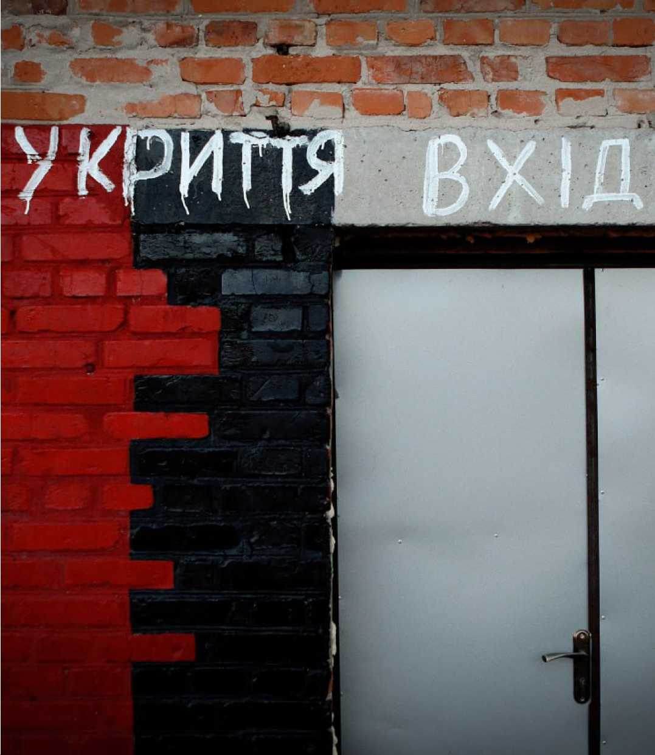
A place of safety
The children of Byshiv, in particular the village of Yasnogorodka, are missing out on in-person education. The knock-on effect is parents and carers unable to go to work to earn money to rebuild their lives.
Children across Ukraine dream of attending school, playing, learning and achieving without the threat of missile strikes and drone attacks.
With no usable shelter to protect the children from attack, Yasnogorodka school cannot legally be used.
To ensure that children can learn and thrive alongside their friends again, we’re seeking immediate support to build a shelter.
Your gift will provide hope among chaos and daily upheaval. It will provide an environment where our young people can flourish academically, emotionally and socially once again. It will begin to give our children their childhood back.
Your gift will be the first step on the path towards a normal life once again.

Slide 10
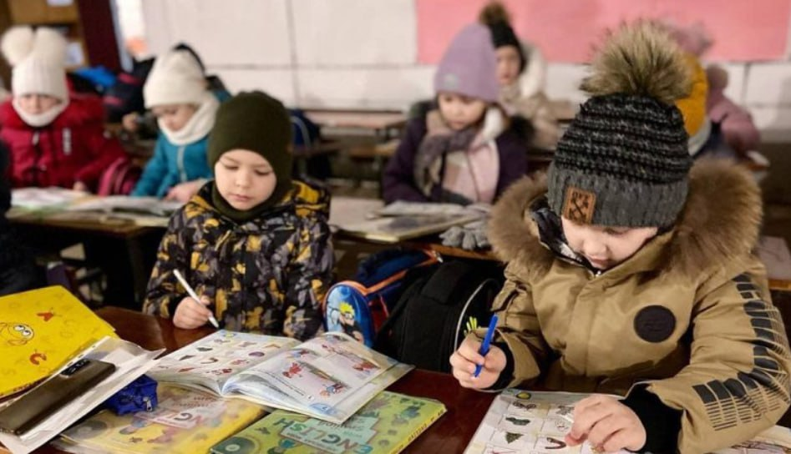
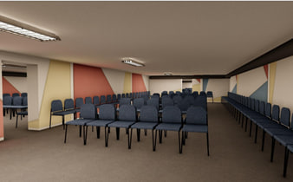
What your funds can support
With your support we can create a 200m² space for 200 children and teachers in Yasnogorodka so that children can continue to thrive at school despite the threat of ongoing war.
We’re looking for generous donations to provide construction costs to create a modern, comfortable and safe shelter with a toilet, kitchen and play space.
In addition, you can help us to fill the shelter with chairs, tables and screens so that our young people have everything they need to learn and play without fear of their lives.
We also hope the shelter can be used as a place of safety and refuge for others across the community in Yasnogorodka.

Slide 11
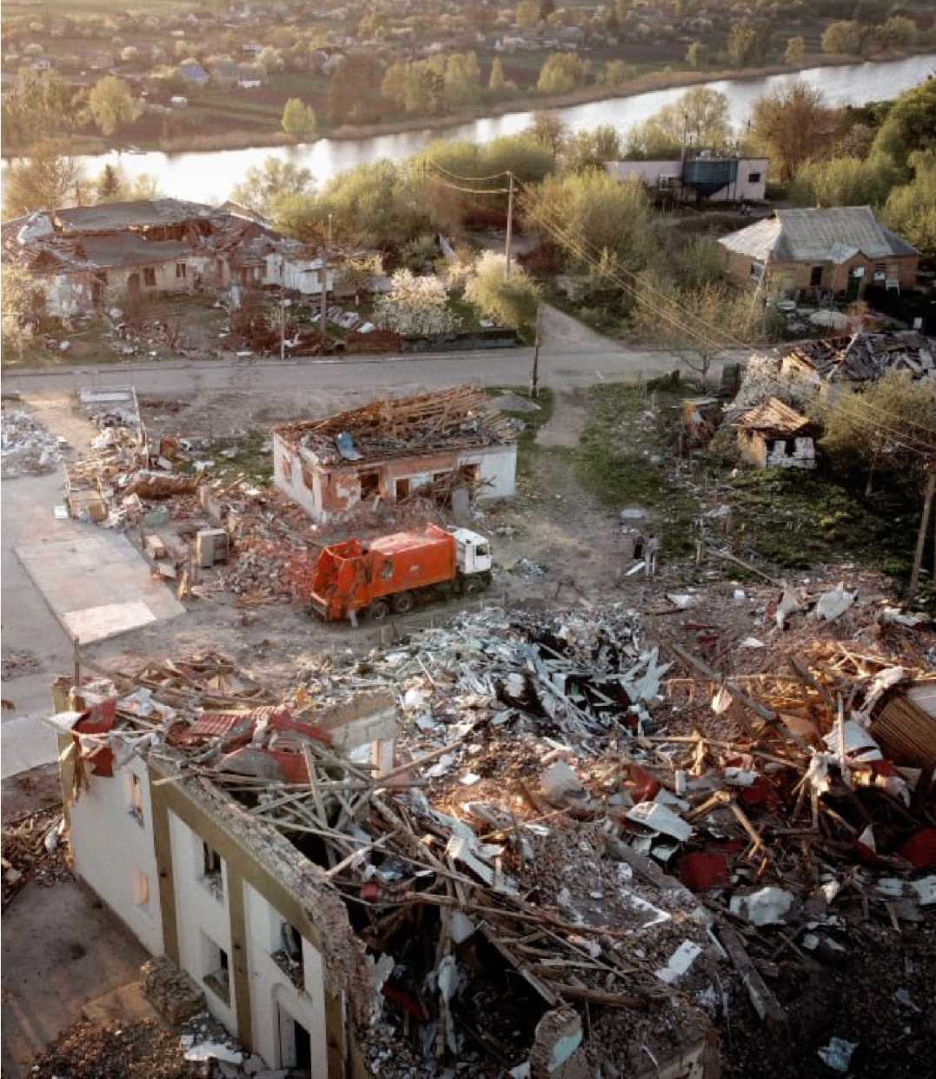
A place of opportunity
The next stage of our community redevelopment programme is to work with the Byshiv residents to create a vision for a thriving post-war Byshiv.
Right now, lives are on hold, livelihoods have been lost and many face the heartbreaking decision of whether to leave their home to become refugees in Europe or beyond. Today, 80% of the Byshiv population has stayed in their hometown.
We want to work together to give them a reason to stay, to provide a vision of hope and renewal and to show those forced to leave that a brighter future will await them in Ukraine again.
Our vision is not to simply rebuild what has been destroyed but to follow internationally recognised ‘build-back-better’ principles.
Your gift will help us create a more resilient, sustainable and inclusive community that is fit for a future long after the war.

Slide 12
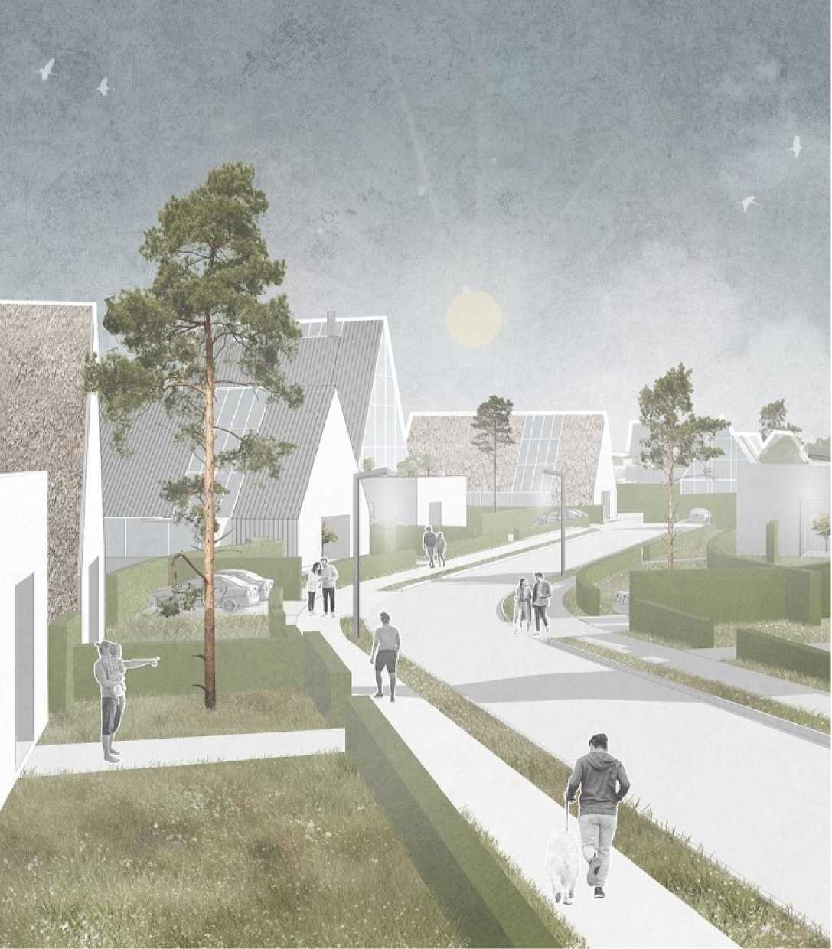
What your funds can support
We’re looking for philanthropic partners to help us develop an innovative community concept approach for Byshiv.
In the coming months, we'll work together to:
Complete an in-depth community study to bring together residents of Byshiv through focus groups and workshops to define their needs and priorities.
Conduct an expert best-practice analysis covering areas such as utilities and communication; green power generation; cultural, health and education development; new business opportunities; and inclusivity and diversity.
Hold a two-day Urban Hackathon to bring together teams of experts and Byshiv residents to develop best-practice concept solutions to meet the needs of the Byshiv community. This allows rapid and interactive development of ideas in a creative and hopeful atmosphere.
The winning approach will be assessed for feasibility and used to create an action plan for the renewal of Byshiv. Our work will be a blueprint for how other areas across Ukraine can attract new residents and investment to breathe fresh life into their communities post-war.

Slide 13
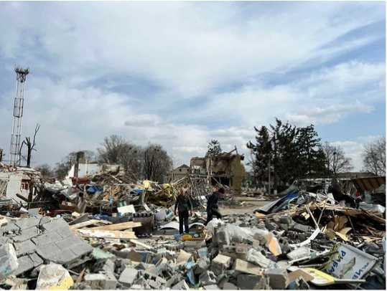
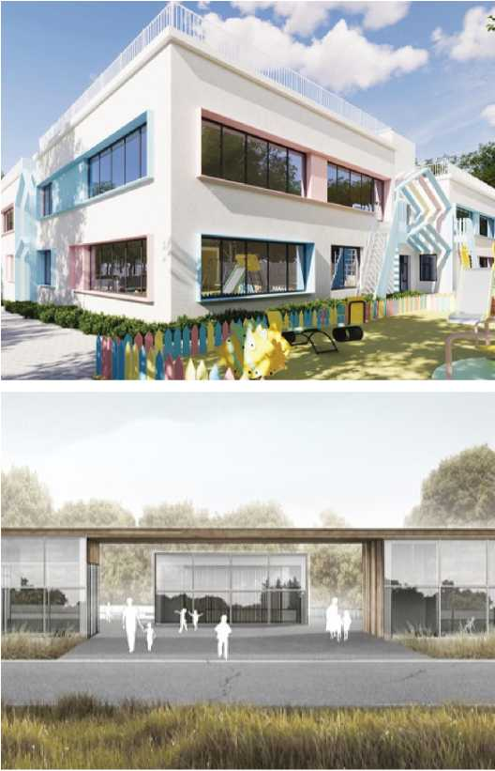
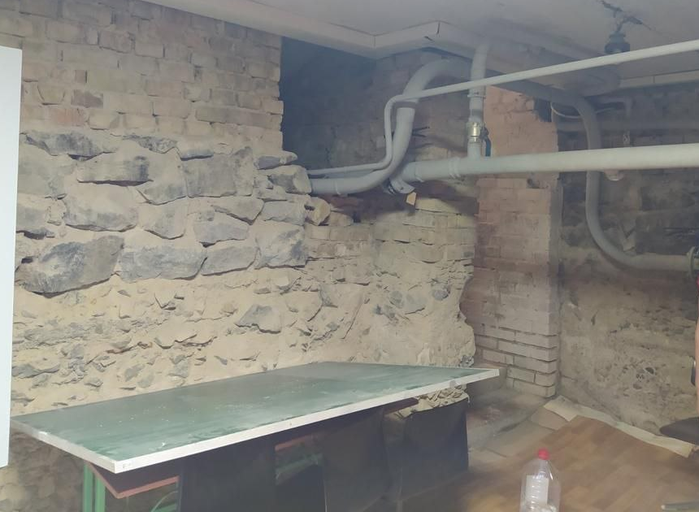
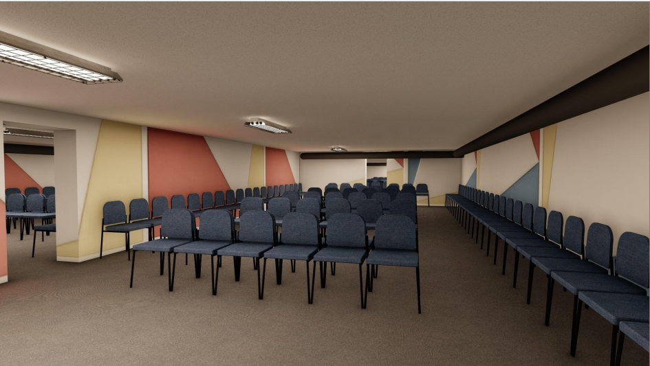
A place to call home
Byshiv Kindergarten: Before and after*
*Artist’s impression
The final phase of our work in Byshiv, which will begin after the victory, involves the phased recovery of the community with the support of national and international government donors, private investors and visionary philanthropists.
Today, 8,000 people in Byshiv do not have access to all medical services, the kindergarten is destroyed and schools are damaged. There are no social and cultural events - the music that once filled the famous Byshiv House of Culture has been silenced.
We invite our charitable partners to support the restoration of this critical social infrastructure.
Over the coming months, we will turn the conceptual designs into detailed engineering documentation and negotiate procurement so that work can begin without delay.
Your contribution will put heart and soul back into Byshiv and Ukraine.
Yasnogorodka School Shelter: Before and after

Slide 14
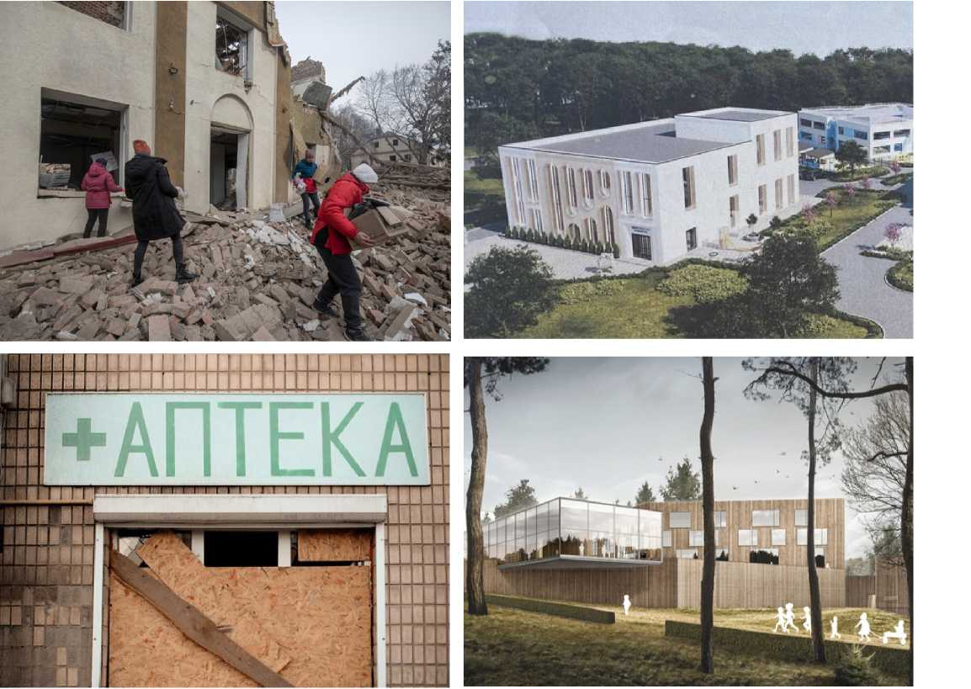
Byshiv House of Culture: Before and after
What your funds can support
We are searching for committed philanthropic partners who can help us transform the following facilities:
Yasnogorodka School Shelter
To build up a shelter allows get permission for off-line learning processes for 200 pupils and teachers.
Byshiv kindergarten
More than 85% damaged by missile attack, you can help create a high-quality centre for child education. Serving 500 families in the region, your gift will give children the best start in life.
Byshiv House of Culture
Once a thriving cultural centre, now almost completely destroyed by rockets. With your support, we can create a modern facility with 500 seats for cultural and social events, alongside a talent development programme to unite the community, recognise and celebrate Ukraine's cultural heritage.
Byshiv Ambulant Clinic
Renewing this half-destroyed clinic will enable 8,000 residents to access quality medical treatment and on-site care.
Byshiv Ambulant clinic: Before and after

Slide 15
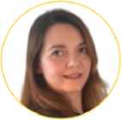
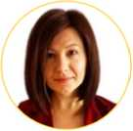

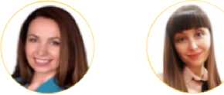
We are URenew
Our people
A global fellowship
The URenew Foundation has been created by a fellowship of professionals with roots in Ukraine. We want to use our skills and experience to give back to our country, creating a strong, united and prosperous Ukraine after the devastation of war.
A deeply personal mission
For many of us, Byshiv is home. We were born in the region and forged our friendships playing in the streets that have now been turned to rubble. It breaks our heart to see the Byshiv community torn down by war and we are committed to building it back up.
A wealth of international experience
The core URenew team is supported by an experienced group of volunteers spread across the world who bring professional skills and expertise in large-scale urban design and development, project management, procurement, construction, IT and governance. Together, we bring knowledge of best-practice in sustainable development and a track record of developing full cycle projects - from feasibility study and financing to go-live.
On-the-ground community links
The real strength of URenew comes by combining our global professional expertise with local knowledge and connections. We’ll draw on this dual strength to upskill and empower Byshiv citizens to shape the renewal of their own region.
A reason to act quickly
Now we have a team and clear plan for redevelopment of Byshiv, we are seeking philanthropic and business investment into the URenew Foundation to kick-start our renewal efforts. A gift to URenew can be given with the reassurance that it will be channelled quickly and directly to the Byshiv community, where it can be put into action without delay.
The URenew Foundation is based in Poland with a project office on the ground in Ukraine. The Foundation is tightly governed by a Supervisory Board and an incoming Honorary Board.
Antonina Vysota
CEO URenew Foundation (Poland)
Julia Romanenko
CEO URenew Project Office (Ukraine)
Maryna Koltsova
Chair of URenew Supervisory Board
Iryna Povoroznyk
Member of URenew Supervisory Board
Viktoria Zabayrachna
Member of URenew Supervisory Board
Our partners
We are pleased to introduce our project implementation partners:
Byshiv Community Authority
IPSM
Crowe Ukraine
Medical Foundation of Moldova
O.M. Shumelda Design and Architecture Studio
Denza Construction

Slide 16
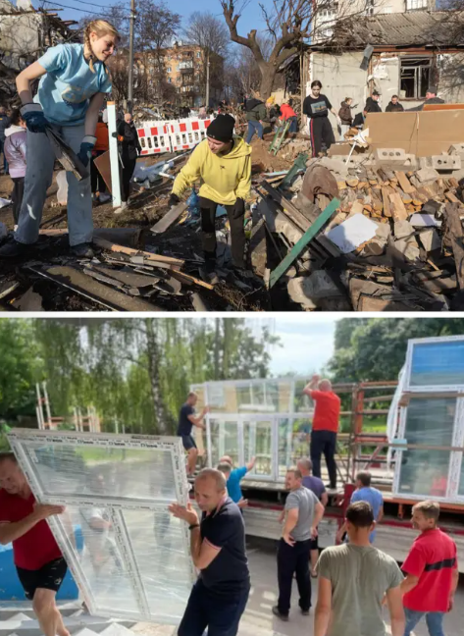
What we can achieve together
We are Looking for philanthropic and investment partners to support our vision of a stronger, better Byshiv. Philanthropic partners will play a key role in working with us to regenerate the social, educational and cultural heart of the Byshiv community. Together, we will:
Reunite a community through high-quality medical, education and cultural spaces
Create a place of belonging where everyone feels welcome
Develop safe spaces for children to Live, play and Learn
Provide the opportunity for residents to regrow their Livelihoods including forging new skills such as entrepreneurship
Build a resilient, sustainable environment based on best urban development practice
Attract business and investment to help a community prosper
Develop a community-led finance model to replicate in other communities across Ukraine
Help a community recover from the trauma of war

Slide 17
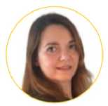
URenew Foundation CEO, Antonina Vysota, answers your questions:
Why support renewal when there are more urgent needs across Ukraine?
Many international agencies and governments are providing funds to support the military and deliver vital aid to millions of refugees fleeing their homes. In comparison, small communities like Byshiv must support themselves with limited resource and opportunity. Our focus is threefold: to provide immediate safety and relief but coupled with long-term sustainable investment in the future. On top of that, we'll share what we do in Byshiv to equip and empower other small communities across Ukraine.
Why support renewal in Byshiv rather than give to a large central reconstruction programme?
The scale of destruction across Ukraine is so extensive that our country will need both to recover fully. Our focus is to work directly with the community on the ground, to put them in control of shaping their own recovery. We believe this model could help small or isolated communities across Ukraine and complement large state-funded reconstruction programmes at a faster pace and with a more inclusive focus on community. We hope to share our insight and approach with other reconstruction efforts across Ukraine, so that we can take best practice from each other and coordinate efforts across the country.
What ways can I support URenew?
While financial support will make the greatest difference to our work now, we would also welcome partnerships that offer in-kind support - whether expertise or time - to enable us to realise our vision for Byshiv. We’d welcome the opportunity to have a conversation about your motivations for giving and how we can harness those to have the greatest impact.
How will I be kept up-to-date with the progress of the project?
As a key partner in the project, you'll be given regular updates on our progress in Byshiv and key decisions being taken along the way. We'll share stories from Byshiv about the impact of our work together and enable you to hear about the plans our experts are developing for the region.
What reassurance can you provide about how donations are spent?
In return for your generosity, we will provide full spend transparency on how your gift is used, overseen by our governance committees. We also offer the reassurance of internal controls at key project execution stages, so you can be confident your gift is being used in the most effective way.
Where is URenew based? Do I get tax benefits for my gift?
URenew is an EU foundation registered in Poland (NIP 7011130968). We are currently setting up giving options in the UK and US to enable tax relief on giving to URenew from these countries. Talk to us for more details.
How will my gift be recognised?
We’d be delighted to work with you to discuss recognition of your gift as well as how you can be an active partner in URenew and in the re-development of Byshiv.
We look forward to working with you.

Slide 18
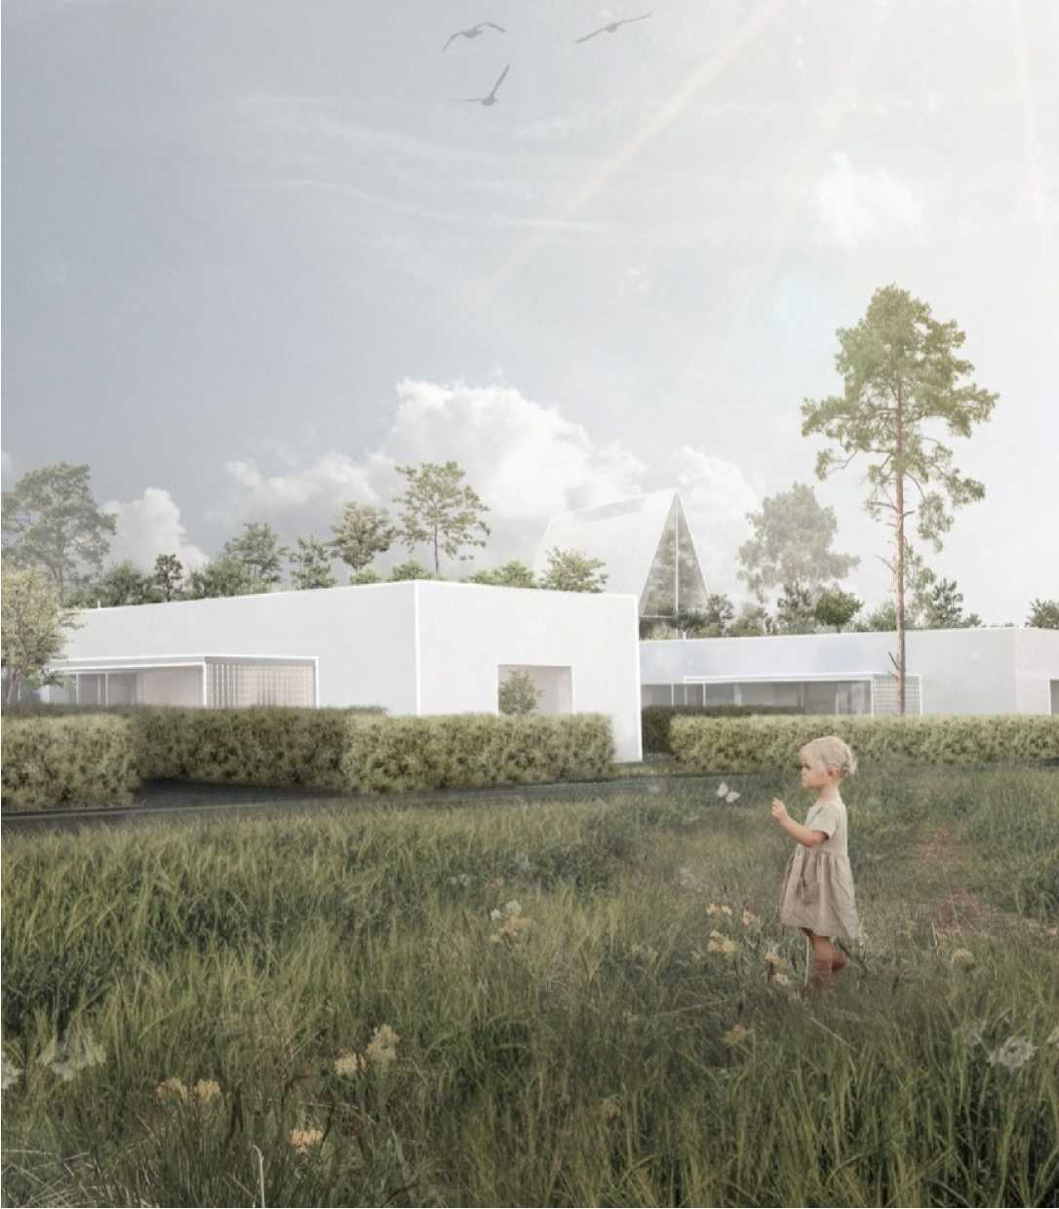
Contact URenew
If you’re here for a better future for Byshiv and Ukraine, we can't wait to speak with you.
You can contact us at:
Antonina Vysota
CEO of U-RENEW Foundation +380679935016 (Ukraine) avysota@urenew.org
https://www.urenew.org

Slide 19

URenew Foundation
Address: Jana Dantyszka street 18, Warsaw, 02-054, Poland
VAT: 7011130968
REGON: 524551579
KRS: 0000967566

