Slide 1
Case to support
Ambulant clinic enhancement
Byshiv community
Kyiv region
Ukraine
November 2023

Slide 2

Cover letter
Dear ladies and gentlemen!
Our URenew team represents a crucial and life-changing initiative that we're excited to share with you. The Byshiv community in the Kyiv region, which was significantly damaged by russian invaders in March 2022, is in dire need of medical equipment to equip its local medical center, and your support can make a profound difference.
Our goal is to ensure that every member of the Byshiv community has access to high-quality healthcare and medical services. With your generous contribution, we can provide essential medical equipment that will improve the health and well-being of the entire community.
Here's how you can participate in this life-transforming endeavor:
Donate: Your financial support is instrumental in acquiring the much-needed medical equipment for the Byshiv medical center. Your contribution will directly impact the health and lives of those in need.
Collaborate: Partner with us in fundraising efforts or collaborate with your resources to help us achieve our goal faster. We welcome strategic alliances to maximize the impact of our project.
Advocate: Use your influence to spread the word about our initiative. Encourage your employees, stakeholders, and networks to get involved and support our cause.
Sponsorship: Consider sponsoring specific pieces of medical equipment or entire sections of the medical center. Your organization's name will forever be associated with the positive change you help create.
By supporting this project, you are not just contributing to the acquisition of medical equipment; you are making a lasting impact on the health and future of the Byshiv community.
Join us in this noble endeavor by donating, collaborating, advocating, or sponsoring. Together, we can make a profound difference in the lives of those who need it most.
Thank you for considering this opportunity to make a positive and transformative impact on the Byshiv community's healthcare system.
Sincerely yours,
Antonina Vysota Julia Romanenko
CEO of U-RENEW foundation (Poland) CEO of URenew Public Organization (Ukraine)

Slide 3
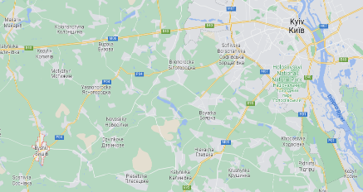
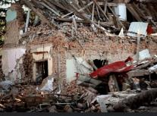

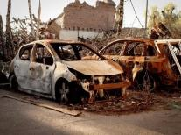
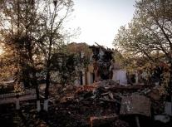
Byshiv community current state
Project prerequisites
Map and some info on Byshiv&Yasnogorodka
Byshiv community was in the war zone. The administrative center of the community, on March 3, 2022, was subjected to rocket fire (there were casualties), and on March 7, 2022, it was bombarded from the air.
As a result, a total of 256 objects were damaged on the territory of settlements:
225 objects of the residential sector were destroyed or damaged, of which 37 buildings are to be dismantled, 32 buildings are to be overhauled, 166 buildings are to be repaired;
31 social and commercial objects were damaged or destroyed – including 2 administrative facilities, 2 secondary schools, 2 kindergartens, 1 cultural center, 1 medical center
Currently more then 100 families with low abilities to rent housing are displaced and can not back to their homes
Renewal requires significant resources, and the Community understands that state aid will be limited and come with significant delays. Therefore, the Community decided to start rebuilding through the world fellowship involvement - humanitarian foundations, sponsors, investors, as well as concerned people from around the world
Byshiv community
Byshiv center village and 14 community villages with own infrastructure
+8000 residents
50 km from Kyiv
280 sq. km territory with a beautiful natural landscape
800 years of historical heritage since Kyiv Rus
10 km of the legendary Serpent`s Walls
1 famous ostrich farm

Slide 4
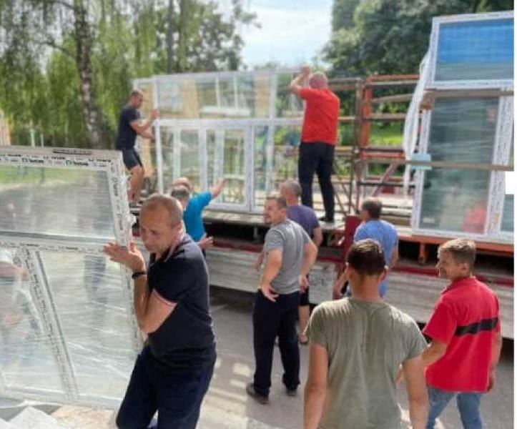
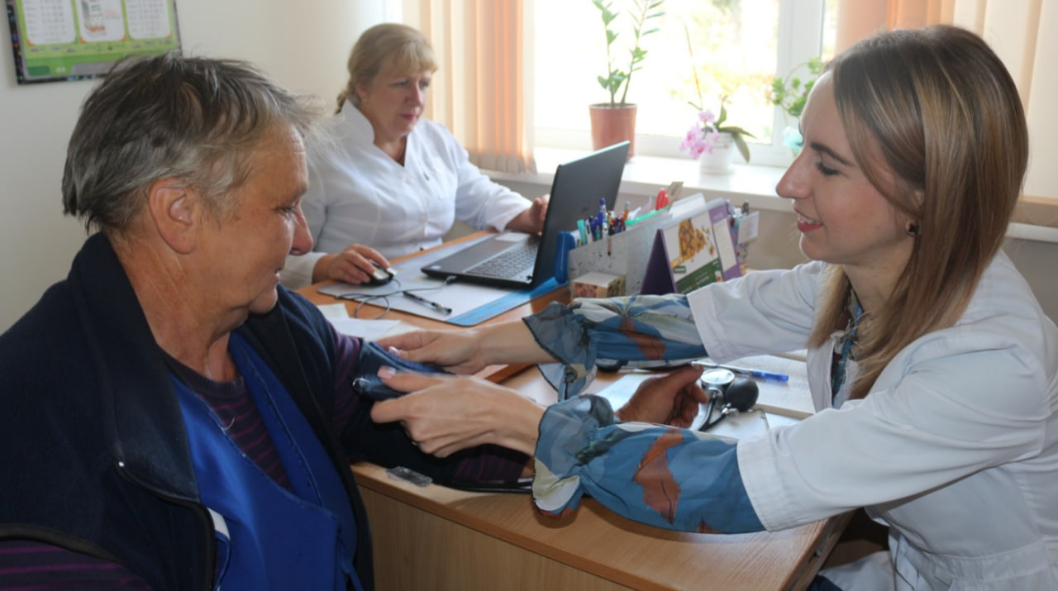

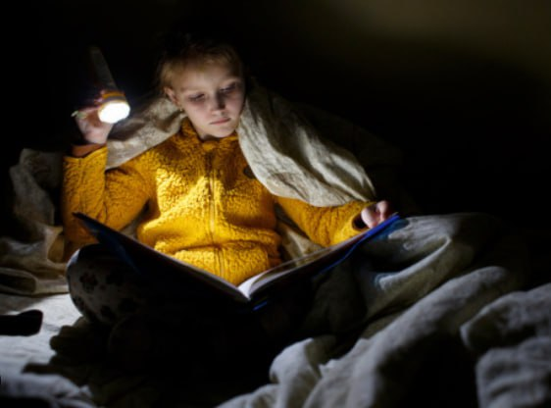
Life goes on
The Byshiv community continues to endure, despite the ongoing war.
Residents persist in their efforts to rebuild their homes, even in the face of regular rocket fire and drone attacks.
The medical professionals at the Byshiv dispensary work tirelessly to treat the community's residents, make diagnoses, and conduct all possible tests. However, the lack of essential diagnostic equipment in the local dispensary takes a toll on the health of the people, particularly the vulnerable members of the population: children, individuals with disabilities, and the elderly.
The acquisition of diagnostic
equipment for the outpatient
clinic will enable over 8,000 community residents to receive
quality medical care. It will aid in early disease detection, preventing complications that oftenarise, ultimately reducing mortality within the community.
Children are determined to acquire knowledge, though offline learning remains inaccessible to many due to the absence of a school bomb shelter.
The estimated cost of the necessary equipment is $109,700.00,
which include:
Spirometer with Pulse Oximeter - $3900
Laboratory microscope with a binocular tube (2 un) - $1800
Mobile X-Ray machine - $60000
Ultrasound diagnostic system - $44000

Slide 5
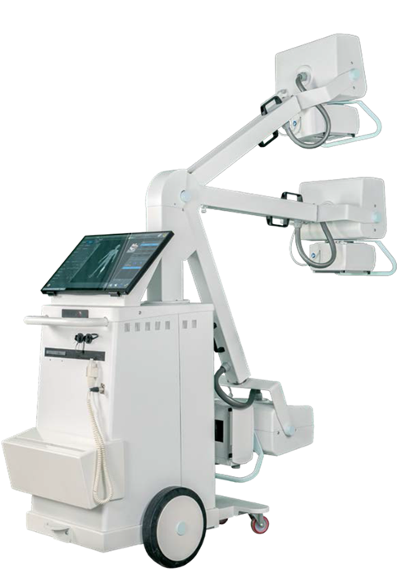
Mobile X-Ray machine
Specifications | v High-frequency X-ray generator with a capacity of 32 kV.
 | v X-ray tube with a rotating anode, focus: 0.6 - 1.3 mm.
 | v Anatomical programs - over
 | v 200 pcs.
Operator interface | v Touch display, which displays all operating parameters, methods of examination of the anatomical area and messages about possible errors.
Obtaining an X-ray image | v Remote control
 | v (preliminary X-ray)
Methods of examining an anatomical site | v Selected and pre-configured methods, with option
 | v manual editing and use of the radiographic control method with two points (kV-mass) or three points (kV-mA-sec.)
Support DICOM 3.0 | v DICOM Print – data printing;
 | v DICOM Storage – data storage;
 | v DICOM Modality Worklist
Available languages | v English, French, Italian, Portuguese, Spanish, Swedish, etc.
Image processing functions: | v brightness / contrast,
 | v negative / positive,
 | v image mirroring (vertical, horizontal),
 | v image rotation,
 | v gamma correction.
Functions of radiometry and visual analysis | v dimensions, distances, angles.
 | v image enlargement,
 | v smoothing,
 | v emphasizing boundaries.
Estimated cost – $60 000

Slide 6
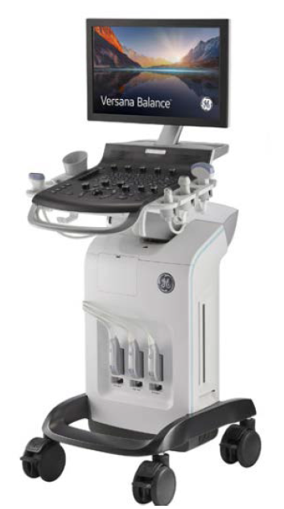
Ultrasound diagnostic system + 3 sensors
(as an example VERSANA BALANCE)
Include:
Uninterrupted power supply source
Sensors (3 units):
Convex sensor 4C-RS
Linear sensor L6-12-RS
Sector sensor 3Sc-RS
Options already included in this device:
General options package for clinical research
General research option
CWD - continuous wave Doppler
Scanning modes: B-mode, M-mode, Color Doppler,
energy Doppler, pulsed-wave Doppler,
Image optimization auto option
Virtual convex
CrossXbeam option - multi-beam scanning
F-Agile architecture with patented beamforming and image reconstruction algorithms
SRI artifact suppression algorithms
Coded harmonic imaging mode
B-Steer
ScanAssistant - research automation protocols
ScanCoach - scanning basic skills training program
3 active ports
4 sensor holders
Estimated cost – $44 000

Slide 7
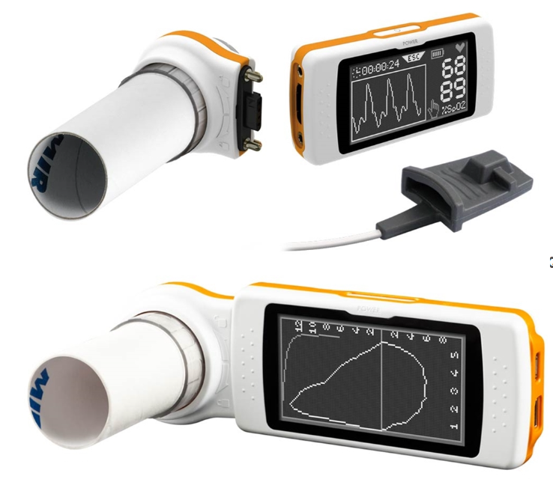
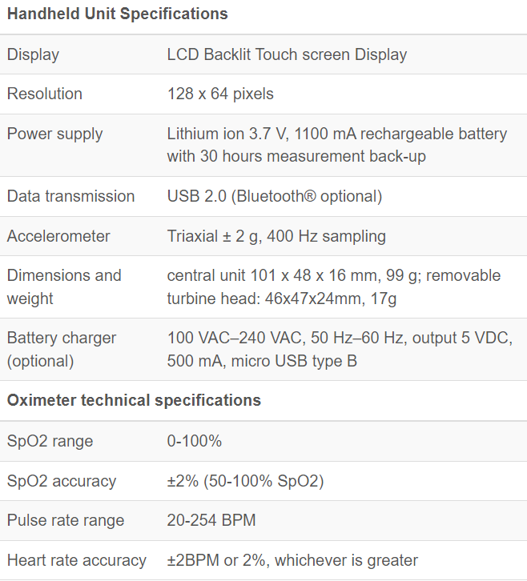
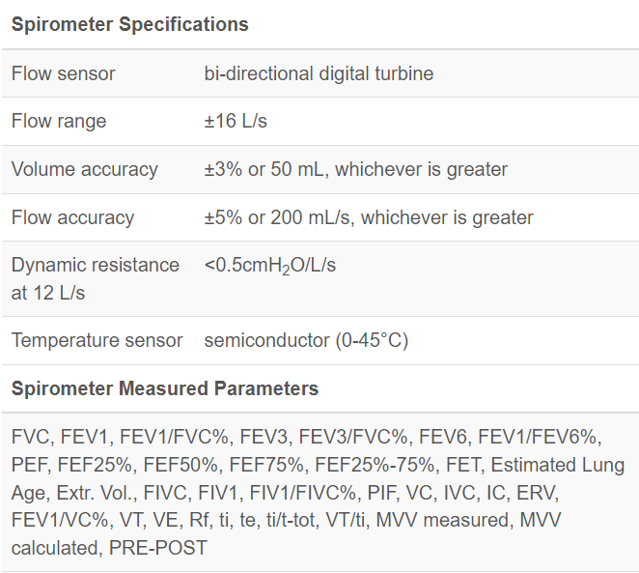
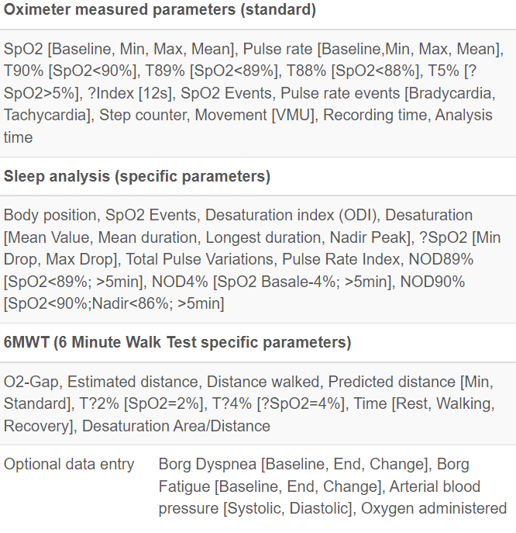
Spirometer with Pulse Oximeter
Estimated cost – $3900

Slide 8
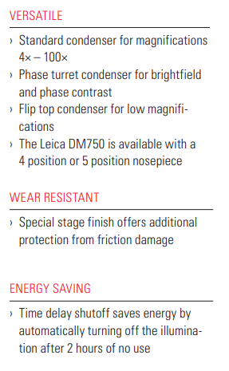
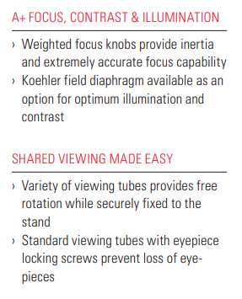
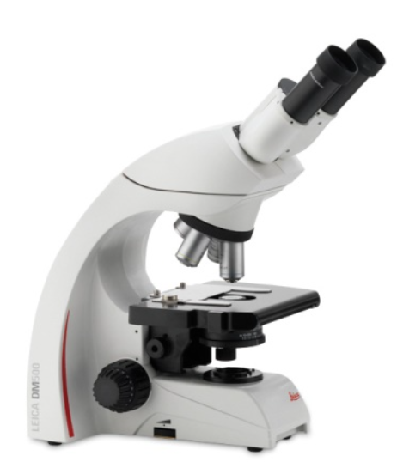
Laboratory microscope with a binocular tube for studies in the brightfield
(as an example Leica DM500)
Estimated cost – $1800

Slide 9
List of necessary Equipment for Byshiv Ambulant Clinic*
Products | Examples of the necessary equipment by Links (or analogues) | Approximate prise without taxes per unit | Quantity | Commercial Proposal
Spirometer with Pulse Oximeter | https://www.spirometershop.com/p-1387-mir-spirodoc-spirometer-with-pulse-oximeter.aspx#:~:text=With%20an%20optional%20oximetry%20module,%2C%20motion%20analysis%2C%20and%20more. | $3 900,00 | 1
 | https://alexmed.in.ua/ua/p1660184582-spirometr-spirolab-spo2.html?source=merchant_center&gclid=CjwKCAjwvfmoBhAwEiwAG2tqzKfV87nSwU3mm8v2glVVWPCPKaI_z6GK8eLsPYw9w3NupyqsBXORyBoCciEQAvD_BwE
Laboratory microscope with a binocular tube for studies in the brightfield | https://www.leica-microsystems.com/products/light-microscopes/p/leica-dm500/ | $1 800,00 | 2
 | https://www.scientificlabs.co.uk/product/MIC5200#overview
Mobile X-Ray machine | https://medray.bg/en/index.php/mobi-dr/ | $60 000,00 | 1 | D:\byshiv\PROJECTS\ambulance\KP Mobi DR (DR Medray)_eng.docx
 | https://www.fujifilm.com/uk/en/healthcare/x-ray/mobile-dr/fdr-nano ** | $125 000,00**
Ultrasound diagnostic system + 3 sensors (VERSANA BALANCE or analog) | https://gehealthcare-ultrasound.com/versana-allround-ultrasound/versana-balance/ | $44 000,00 | 1 | D:\byshiv\PROJECTS\ambulance\CP Versana Balance 3_eng.docx
*according to request - letter N77 dated 15.09.2023
** total cost include only cheaper variant of solution

Slide 10
If you ready provide a gift…
… and your gift is less then 1 000 $
..and your gift is more then 1 000 $
Visit our website and donate through Donorbox:
https://www.urenew.org/
Choose the legal entity which is more suitable for your gift:
U-RENEW Foundation (Poland)
U Renew Public Organization (Ukraine)
1.
1.
Let us know if you want to publicly disclose your gift through our social media by contacting avysota@urenew.com.ua
2.
Contact Antonina Vysota for gift agreement signing
avysota@urenew.com.ua
2.
... and you are the USA resident
Please keep in mind that our project is fiscally sponsored of the Edward Charles Foundation (501(c)(3) non-profit organization)
3.
Sign gift agreement, provide a gift
1.
Follow-up the project status through our social media

Slide 11
URenew Mission and Values
URenew platform was launched by world fellowship to help Ukrainian communities with renewal after war destruction.
The aim of the project is to help communities to overcome current disaster bringing best world expertise and urban practice as well as attract funds for reconstruction and development
The pilot area – Byshiv community, Kyiv region, which was significantly damaged after russian occupation
Our Mission and Vision
Our Values
Here for the best future!
Comfortable and green environment
Renew community in accordance with best urban development practice and sustainability requirements
Place of choice for living
Ensure long-term community development through boosting high quality medical, education and cultural services, as well as inclusive environment
Wealthy and stable community
Create investment opportunities to attract business and generate new income streams for the community
World’s best practice to serve community needs. Most of the team members operate global with full awareness of the local context. It helps to combine community needs with world’s best practice.
Excellence and professionalism in project execution. URenew have gathered great team that is able to deliver full-cycle projects – from feasibility study and financing to go-live.
Integrity and transparency in everything we do. Our legal and operating model ensures full spend transparency - different legal entities and teams are responsible for fund raising and project execution. We assure effective internal controls at key project execution stages – sourcing and construction control

Slide 12
How URenew helps to renew community
Key challenges community meet during reconstruction
How URenew brings value
Lack on expertise at the community level on: project management mid- and high--scale housing development sustainable technologies |  | Our team has strong experience in implementing mid and large-scale development projects using most advanced sustainable technologies and project management approaches around the world – in Ukraine, CIS, EU, GCC areas
Lack of procurement best practice and expertise together with high corruption tolerance index (in whole country) |  | We pay special attentions to ensure full spend transparency and operations efficiency through: Involving best and world-recognized procurement experts in Ukraine to source our projects executing independent construction control auditing our activities by Big4 consulting team
Lack of expertise on fundraising and grant seeking |  | Our team has experience in fundraising using donorship inputs – we work with the biggest philanthropic organization around the world
No proper infrastructure in place – IT, tools, governance |  | URenew brings world’s best practice on: process tracking using ERP-system project management tools experienced experts on process automation
Lack of any HR resources - due to displacement and budget deficit community faced lack of qualified resources to execute even routine job |  | Except bringing our own expertise we put a lot of efforts to involve community and upskill its members through training session and special camping on strengthening community power
1.
2.
3.
4.
5.

Slide 13

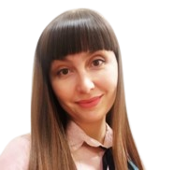
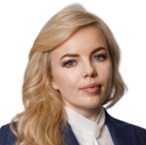
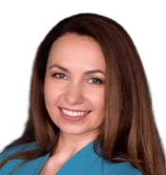
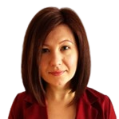

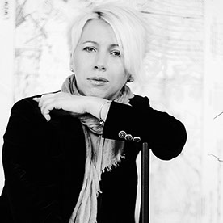
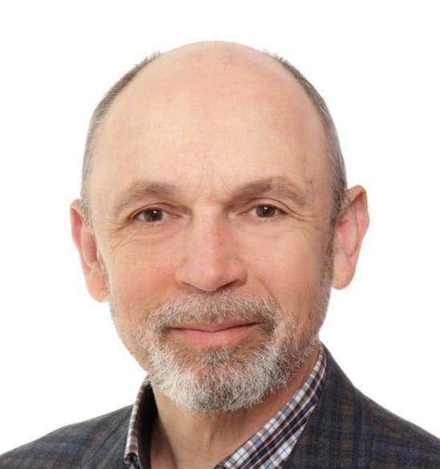
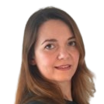

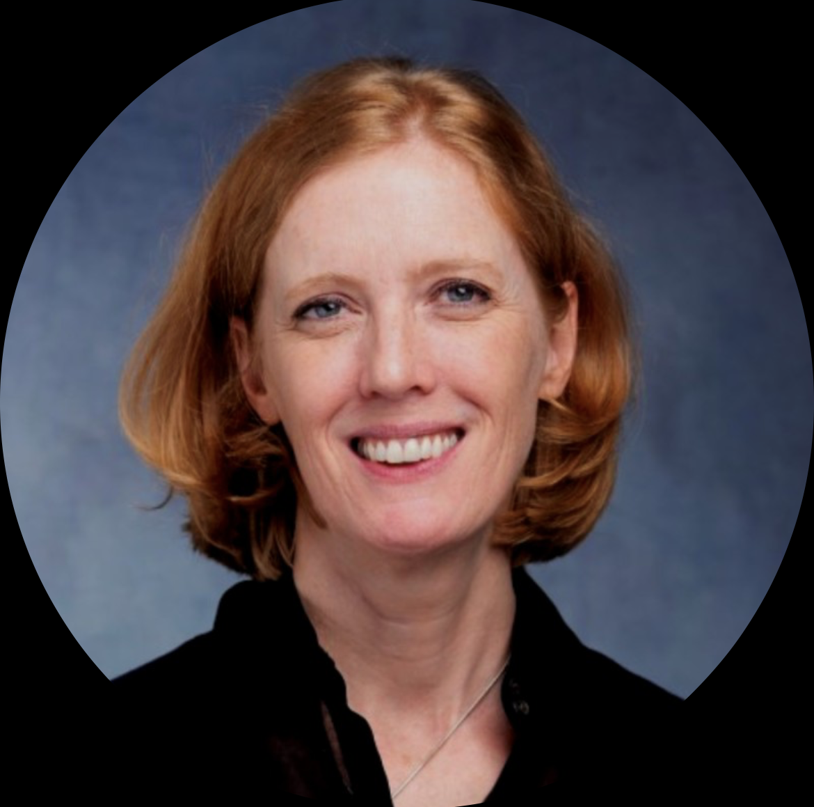
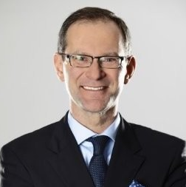

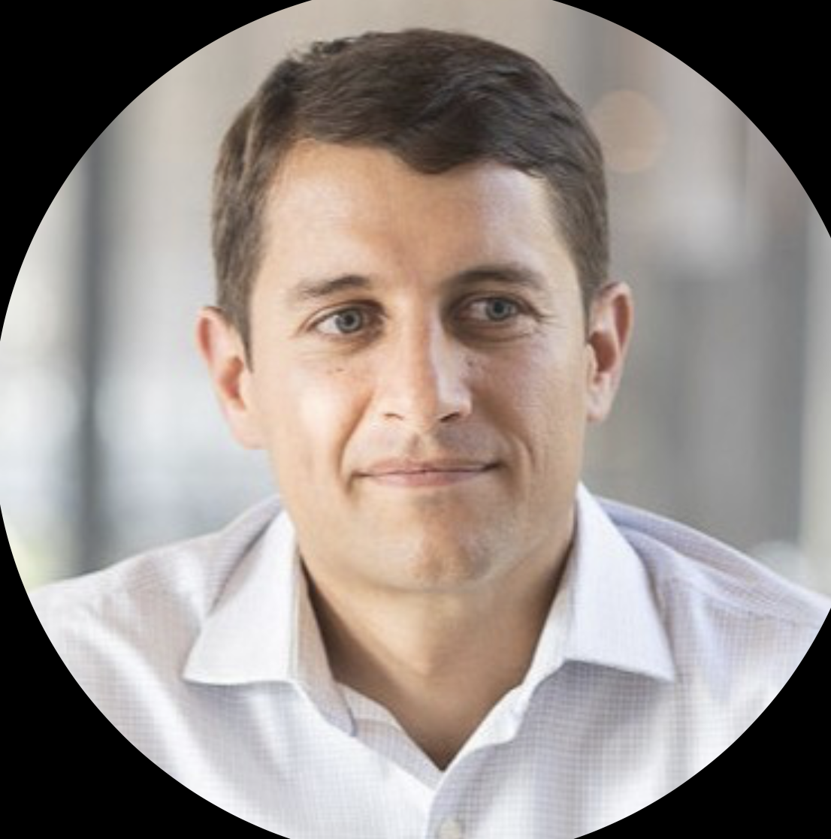
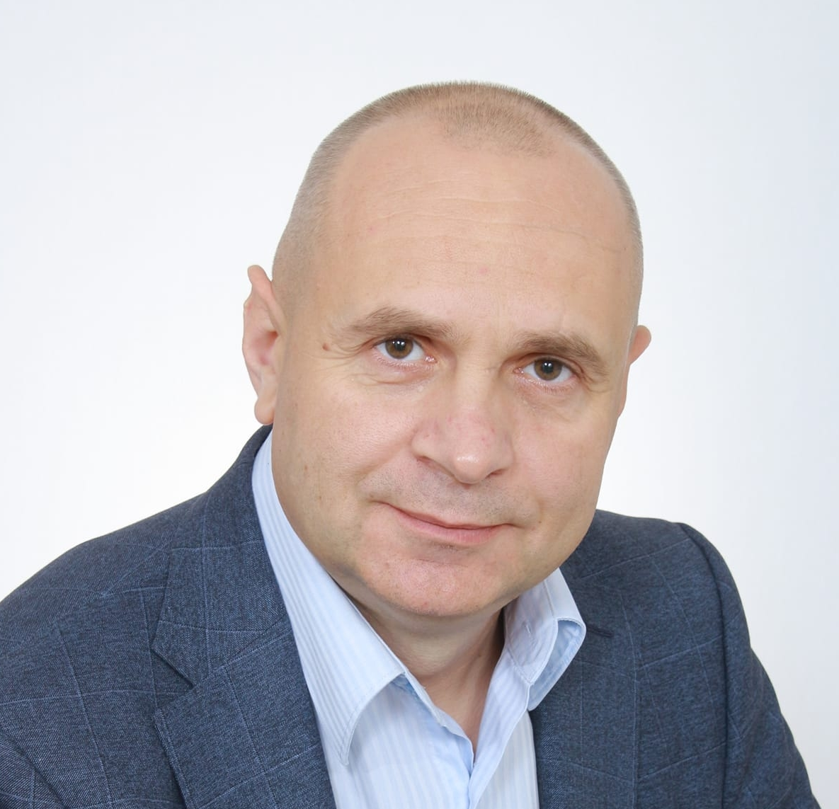

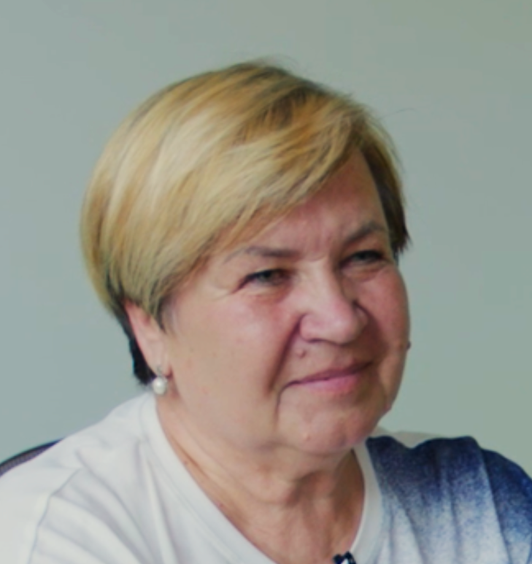


Our wizards for community renewal
URenew foundation
URenew project office
Supervisory Board
Victoria Zabayrachna
Maryna Koltsova
Iryna Povoroznyk
Julia Romanenko
Pavlo Podtopta
Oksana Shumelda
Member of the supervisory board, ACCA, Certified internal auditor
Chairman of the supervisory Board, MBA
Member of the supervisory board, MBA
Head of project office URenew/Financial controller
Owner of Denza Construction,
Project partner on project management and development
Project partner on urban conceptual design
Management team
Stanislav
Melnyk
Antonina Vysota
Maryna Trepova
Joanne
Dixon
Robert Grygiel
Accounting and reporting
CEO of URenew foundation
Founder of IPSM, MBA
Project partner on Sourcing
Managing director
Energy Markets Group, MBA
Project partner on green power
President of Wapeco, MBA
Project partner on Sustainable technologies
Byshiv community representatives
Back-office support
Legal support
Halyna
Nazarenko
Viktor Ghereg
Sergii Ostapchuk
Ivan
Roznai
Lyubov Shamota
Head of Byshiv Community
Former head of Byshiv satellite community (Yasnogorodka)
School principal in Yasnogorodka
Founder of Medical Foundation of Moldova, MBA
Project partner on Medicine
Partner on compliance and digital processes
Marketing team

Slide 14

Legal status
Legal status of URenew in EU
Legal status of URenew in Ukraine
Legal status of URenew in USA
NGO
number of identification KRS: 0001020760
VAT – 7011130968
Public organization, ID 45122005
Is a fiscally sponsored non-profit organization project of the Edward Charles Foundation which is a 501(c)(3) non-profit organization (Tax ID# 26-4245043).
Address
Address
Address
Jana Dantyszka street, 18, Warsaw,
02-054, Poland
Yasnogorodka, Kyivska street, 47, Fastiv district, Kyiv region, Ukraine
Mailing Address: U-RENEW Foundation
269 S Beverly Drive, #338
Beverly Hills, CA 90212
Attention: Kent Seton
Registration date
Registration date
Registration date
23-02-2023
18-04-2023
August 2023
Supervisory board
Founder
Founder
Maryna Koltsova - Chairman of the Board
Iryna Povoroznyk – Member of the Board
Viktoriya Zabayrachna – Member of the Board
Julia Romanenko
Halyna Koltsova
Maryna Koltsova
Serhii Ostapchuk
Iryna Povoroznyk
CEO of the foundation
CEO of URenew Project office
CEO of URenew fiscal sponsored project
Antonina Vysota
Julia Romanenko
Antonina Vysota
Payment details
Payment details
Payment details
Bank: POLSKA KASA OPIEKI SA - BANK PEKAO S.A.,
GRZYBOWSKA STREET, 53-57 , WARSAW, 00-844, Poland
EURO: PL60 1240 1040 1978 0011 2358 4570
USD: PL09 1240 1040 1787 0011 2358 4756
PLN: PL02 1240 1040 1111 0011 2358 4150
SWIFT: PKOPPLPW
Bank: FIRST UKRAINIAN INTERNATIONAL BANK
UAH: UA763348510000000026003200425
EUR: UA763348510000000026003200425
SWIFT: FUIBUA2X
Enterprise Bank & Trust
150 N Meramec Avenue
Clayton, MO 63105
U-RENEW Foundation
Account #: 2405124
Routing No: 081006162

